Slide 1

Presentation on
Coastal Vulnerability using Remote Sensing and GIS
By
Dr. R S Mahendra
Scientist ‘F’, ARO Division,
mahendra@incois.gov.in
OTGA-INCOIS Training Course on "Coastal Vulnerability Mapping and analysis using QGIS" during November 25-29, 2024.
Organized by International Training Centre for Operational Oceanography (ITCOocean) ESSO-INCOIS, Hyderabad, India

Slide 2
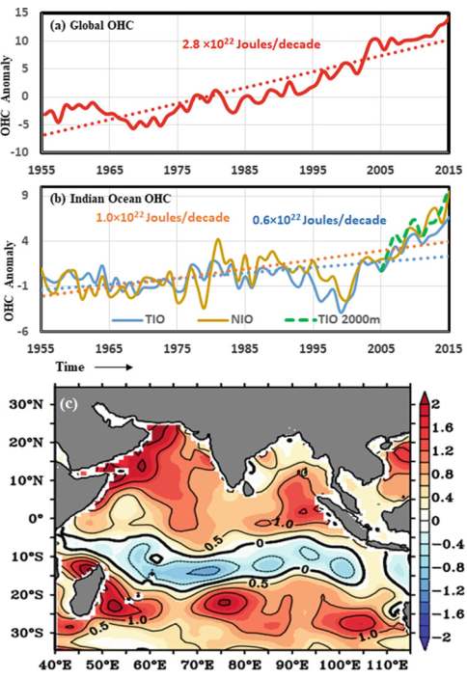
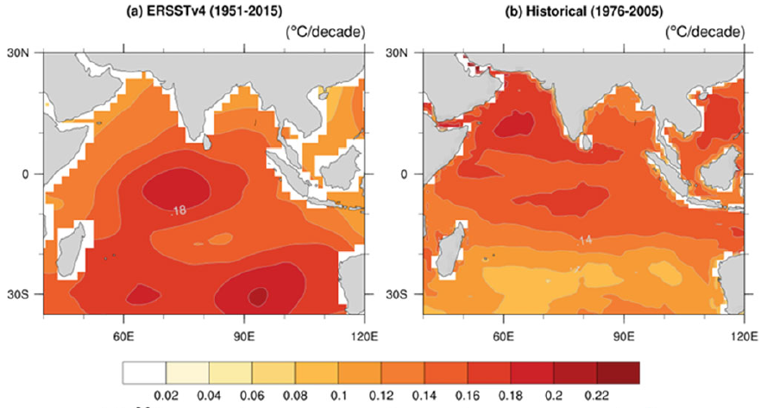
Impact of climate change on the Indian Ocean
SST trend (ºC/decade) from: (a) observed Extended Reconstructed Sea Surface Temperature, version 4 (ERSST v4) during 1951– 2015, (b) CMIP5 historical simulations for 1976–2005.
(a) Time series of global heat content anomaly for the 0-700 m (in 10²² Joules). (b) for Indian Ocean. (c) Spatial heat content anomaly (0-700 m) for Indian Ocean (10²² J/decade)
MoES Climate Assessment Report
Notes:
Added detail in the caption of the left side figure. Modified references by including journal name.

Slide 3
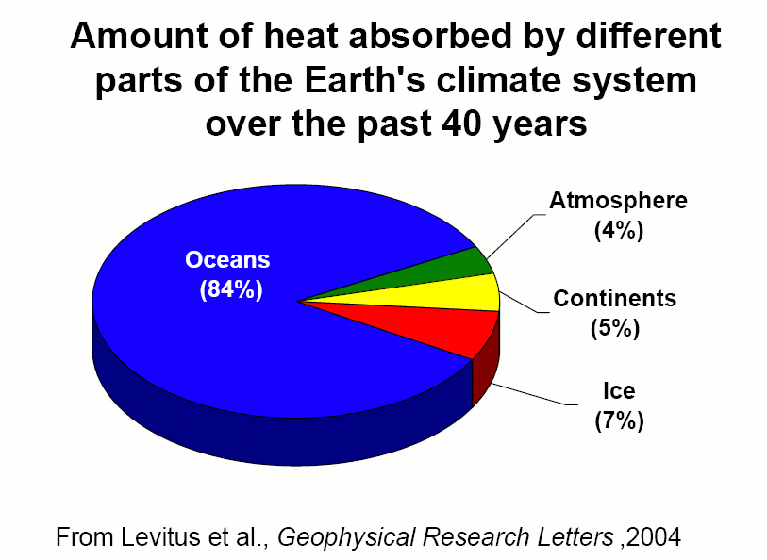
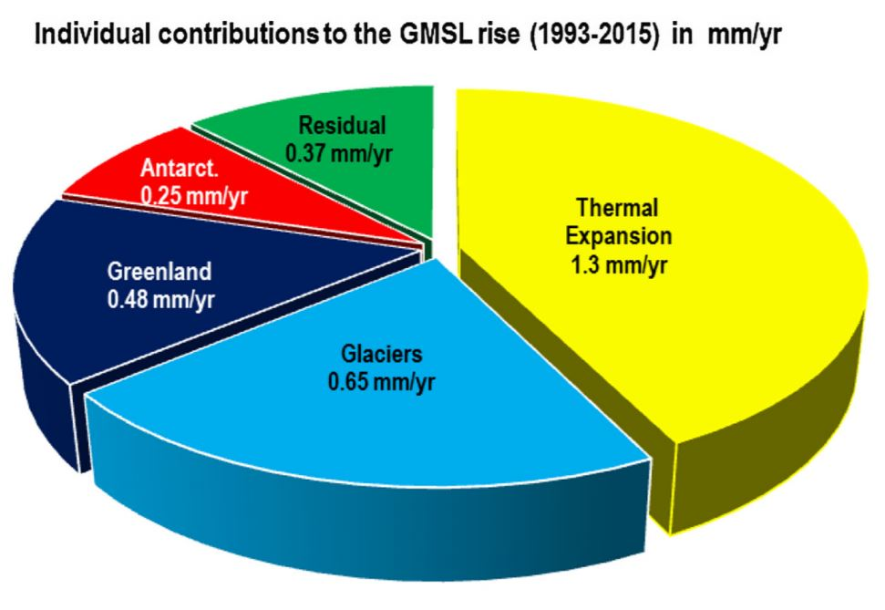
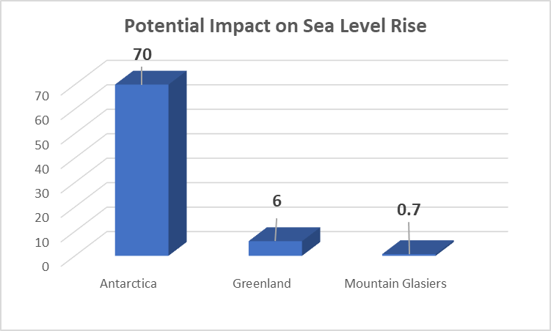
Where Does the Heat Go?
Source: Cazenave et al 2018
Source: Laury Miller, NOAA Lab for Satellite Altimetry

Slide 4
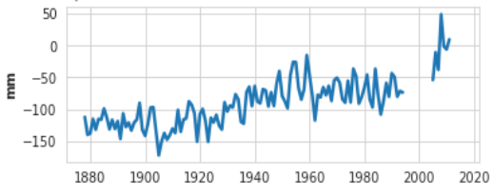
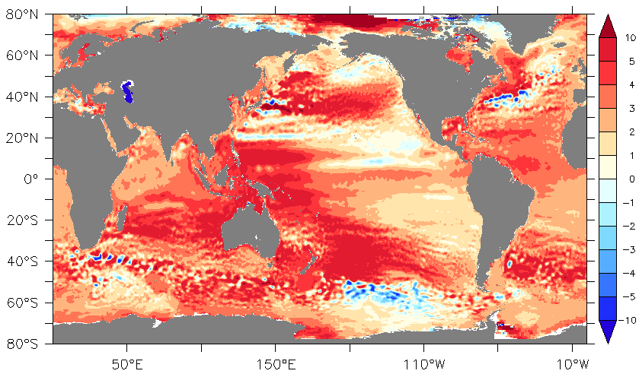
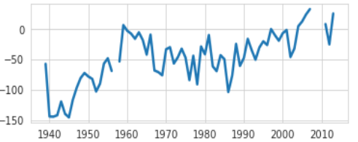
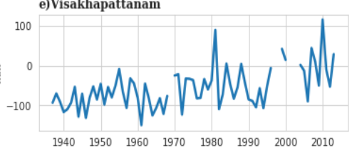
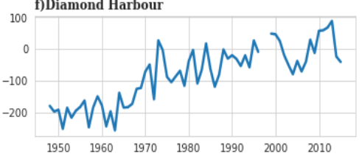
Sea Level Rise in the Indian Ocean
Mumbai
100 mm
Kochi
150 mm
Vizag
150 mm
Kolkata
(Top) Sea level trend during the altimeter duration show large spatial variability across the globe. In the tropics, the maximum sea level rise of more than 5 mm/yr is observed in the western Pacific, south tropical Indian Ocean and in the northern Bay of Bengal.
300 mm
Relative Sea level change based on the tide gauges located along the west and east coast of India suggest a 10-30 cm of sea level rise during the period of 1950-2015.
Notes:
Added detail in the caption of the left side figure. Modified references by including journal name.

Slide 5
Current Rate Nearly Twice the 20th Century Rate Largely Due to Volume Changes
Sea Level Budget Changes With Time
1920 - 1990 1992 - 2003
3.2 mm/yr
1.8 mm/yr
1.7 mm/yr
1.5 mm/yr
1.3 mm/yr
0.5 mm/yr
Volume
Mass
Total
Volume
Mass
Total
Source: Laury Miller, NOAA Lab for Satellite Altimetry

Slide 6
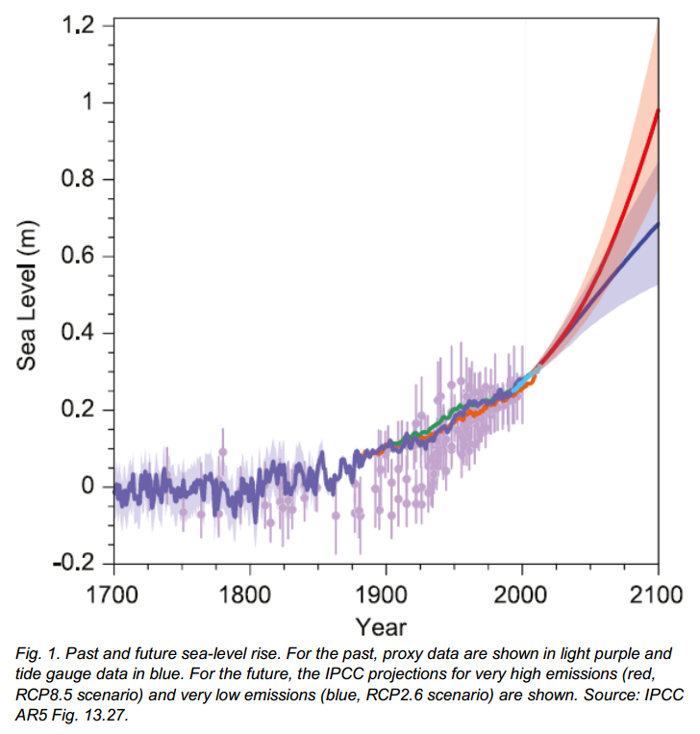
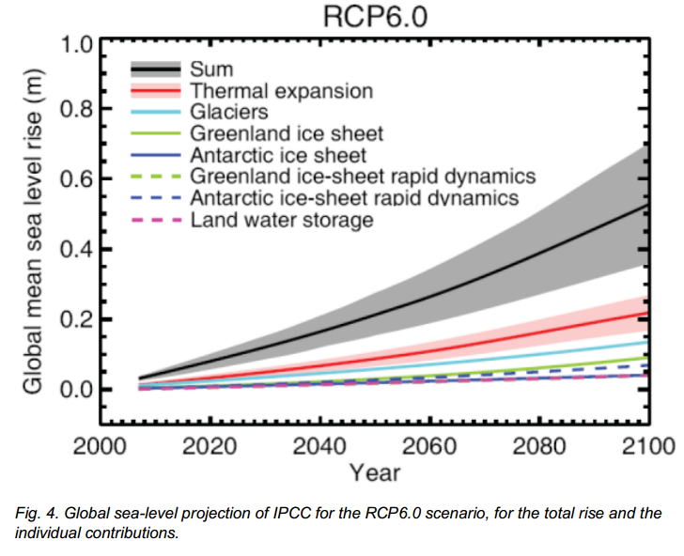
Sea-level rise Global Scenario
Representative Concentration Pathways (RPCs) 6.0
Average global sea level rise 1.8 mm/y
RCP | Criteria | Radiative Forcing (W/sq m) | Mean rise (cm) | Range (cm)
4.5 | GHG emissions peaks around 2040 then decline | 4.5 | 53 | 36-71
6.0 | GHG emissions peaks around 2080 then decline | 6.0 | 55 | 38-73
8.5 | GHG emissions continue to rise throughout | 8.5 | 74 | 52-98
Green House Gas (GHG) emissions (measured in CO2 – equivalent)
Source: 5th IPCC report

Slide 7
Altimeter Record of Sea Level Rise Over Past 15 Years

Slide 8
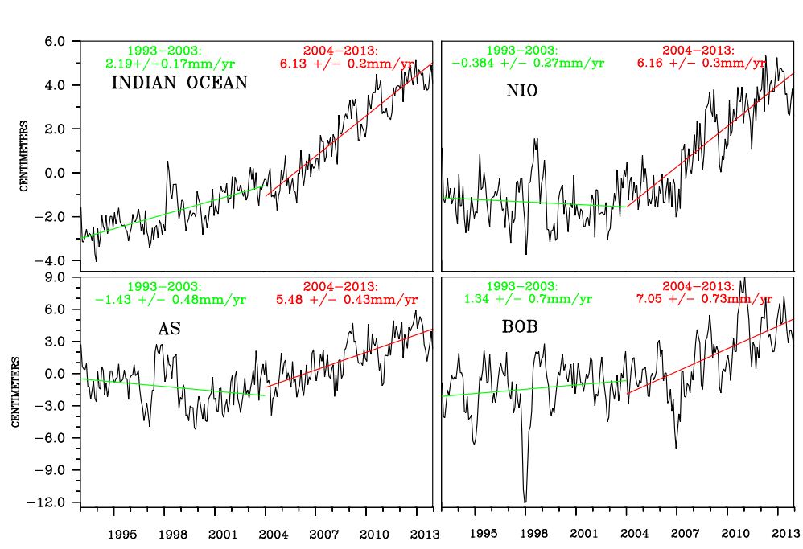
Indian ocean sea level Observations (Altimeter)
Notes:
Region wise increasing trend of sea level of INDIAN OCEAN(x=30E:120E,y=30S:30N), NORTH INDIAN OCEAN(x=40E:100E,y=0:30N), ARABIAN SEA(x=50E:78,y=8N:26N) and BAY OF BENGAL (x=77E:103E,y=5N:23N). All regions especially NIO are characterized by sharp rise in the increase trend of sea level for the period-II (2004-2013) relative to the previous period-I (1993-2003).
Source: Altimeter

Slide 9
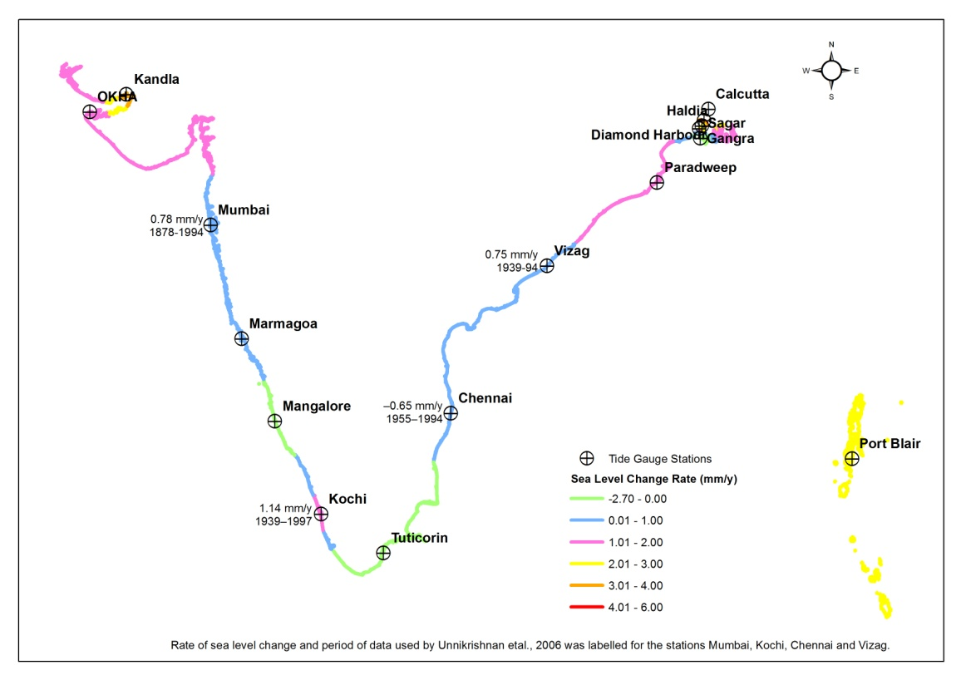
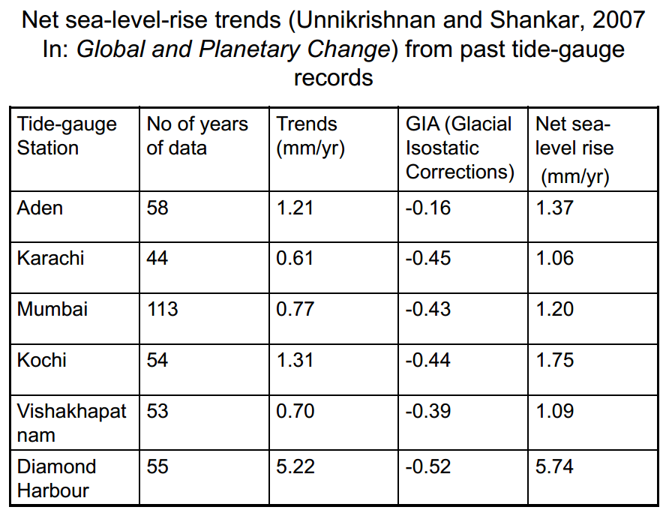
Sea-level rise Indian Scenario
Diamond Harbour | 5.04
Mean sea-level-rise trends along the Indian coasts are about 1.30 mm/yr based on past tide gauge records. Even with the same rate expected SLR of about 13 cm by 2100
SLC=0.74mm/y
SLC=5.04mm/y

Slide 10
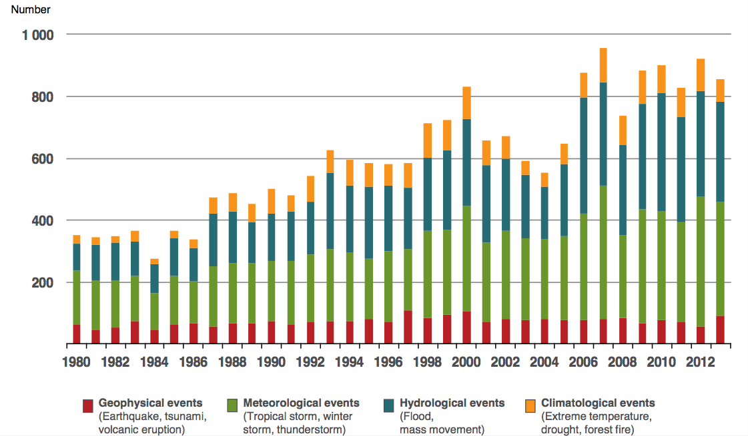
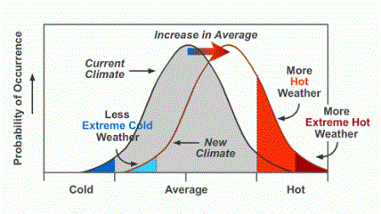
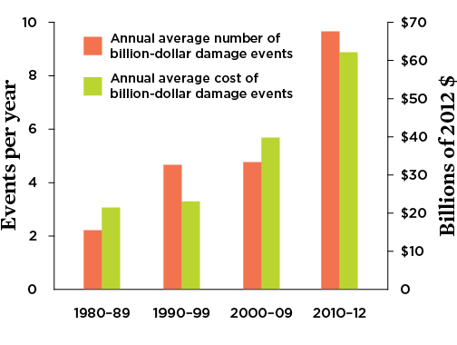
Implications of climate change and sea level rise

Slide 11
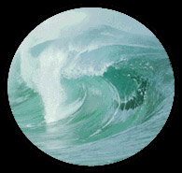
Importance of Oceans and Coasts
Our Planet Earth
70% Oceans
20% Coasts
The Oceans
A Vital Source for Resources
A Driving Force for Monsoons
A Realm for Cyclo-genesis
A Medium for Transport
A Strategic Space
The Coasts
A Fragile Coastal Ecosystem with a Large Community around
High biological productivity (14 %), wealth of species and genetic diversity (90 %) and fluvial discharge (75-90 %).
High rates of population growth, development of industries, trade and commerce (60 % of human population, 2/3 of the world’s large cities)
Degradation of ecosystems, diminishing living resources and deteriorating water quality.
Episodic events, cyclones, floods, tsunami, etc.
Impact on climate.

Slide 12
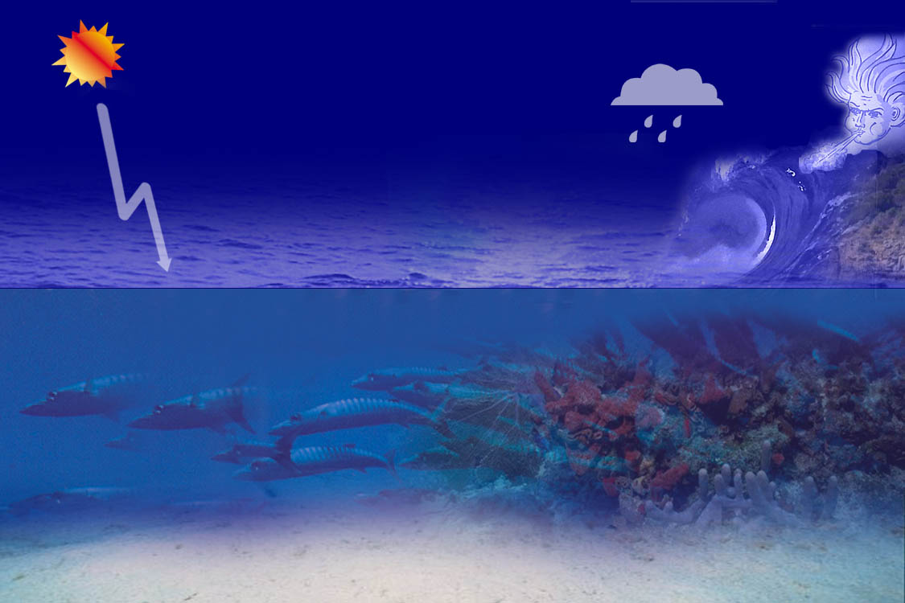
Dynamical Oceanic Processes
Coastal
topography
Waves
Tides
Physical
processes
SST
Sea Level
Coastal / Estuarine Dynamics
Mixed Layer Dynamics
Fronts
Up-welling
Ocean Circulation
Biological processes
Productivity
Biota
Chemical Processes
Salinity
Nutrients
Co₂ sink
Bottom Topography

Slide 13
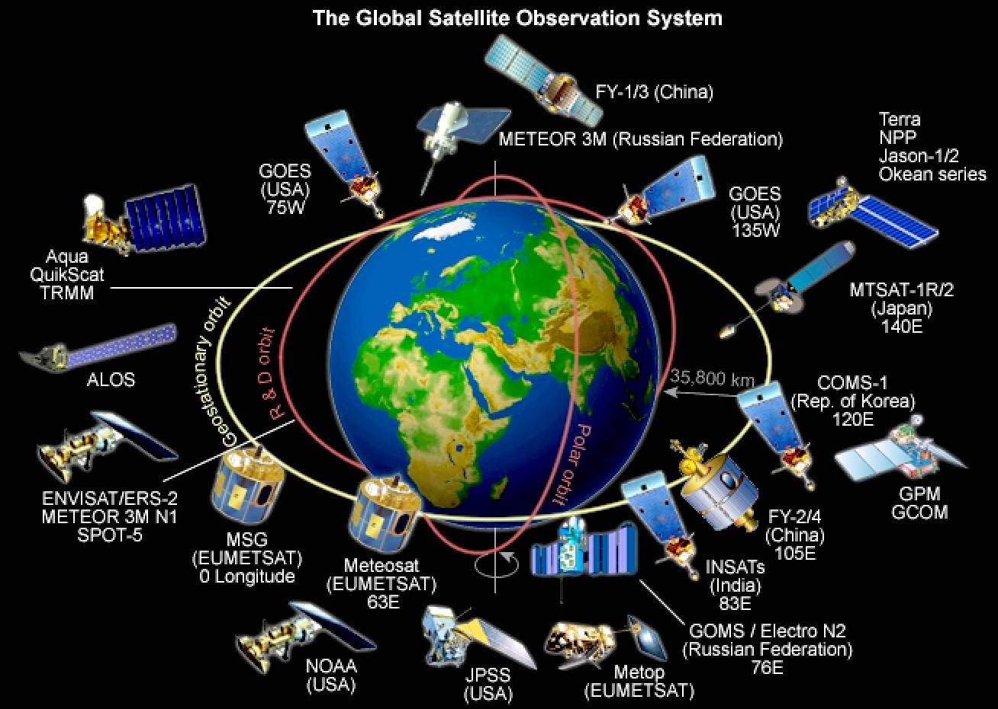


Remote Sensing Observations
IRS
Oceansat-1, 2 & 3
Role of RS in Coastal Management
Development of accurate, up-to-date and comprehensive scientific data base.
Coastal & Ocean Information Services
Inventory on habitats, landforms, shoreline, land use, exploration of fisheries, mitigation of disasters, understanding sediment dynamics, etc.
Provide Inputs for making decisions on construction setback lines, site selections, risk analysis, ecosystem modelling, etc.
Radiometer
(VIS-TIR)
Radiometer
(VIS, NIR)
Radiometer
(MW)
Altimeter
Scatterometer
SAR
SST
Ocean Colour
Coastal Process
Coastal land use
Wind Speed
SST
Sea Ice Extent
Wave Ht.
Sea Level
Sea Ice
Elevation
Surface Wind
Vector
Wave Spectrum
Sediment
Oil spill

Slide 14
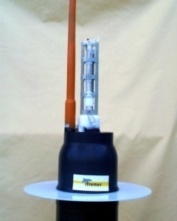
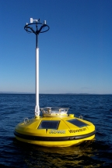
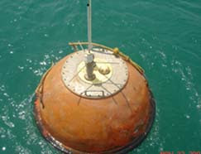
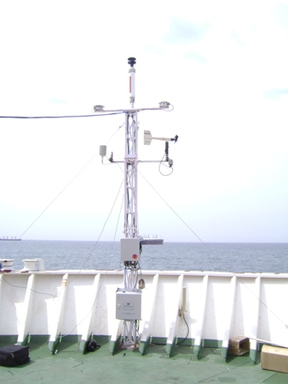
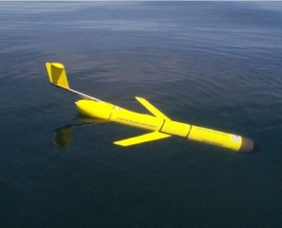
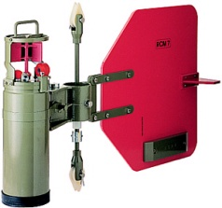
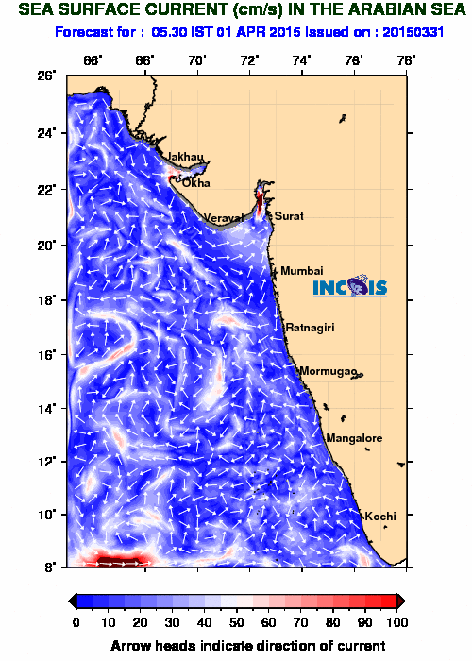
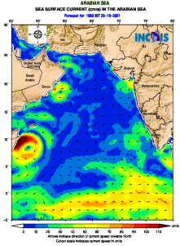
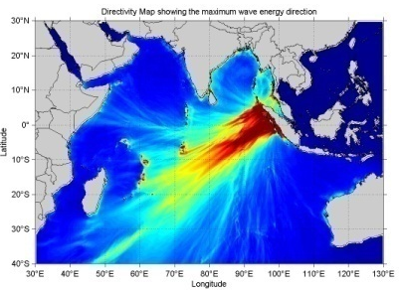
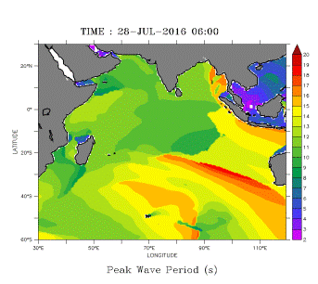
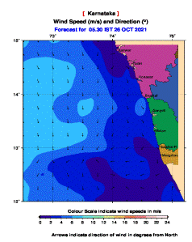
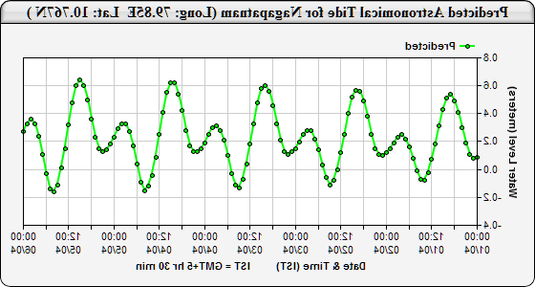
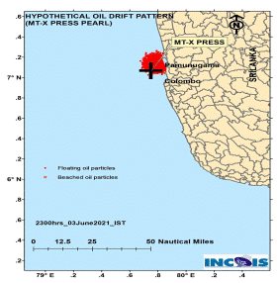
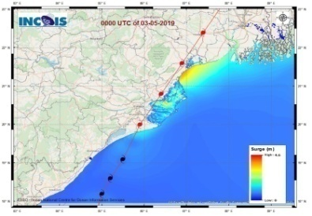
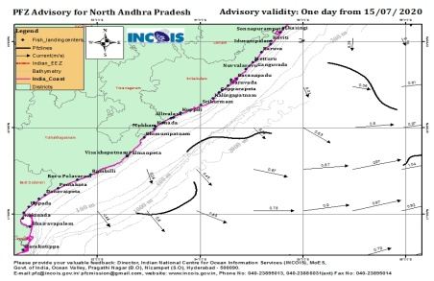

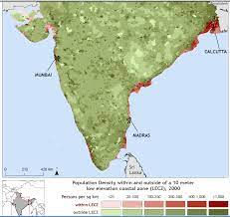
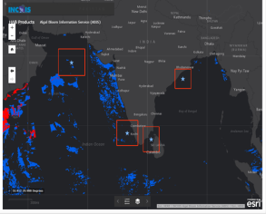


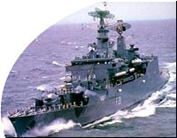
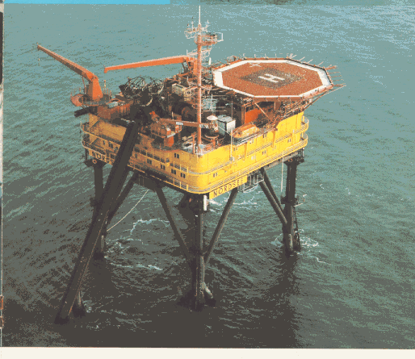
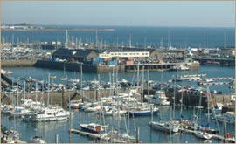
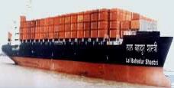
Ocean Information System for blue economy
Customized products
Hazard based products
Modeling/Research
Ocean Information/ Advisory services
Multi mode Dissemination
Real time observations
Fisheries & Ecosystem services
STAKEHOLDERS OF BLUE ECONOMY

Slide 15
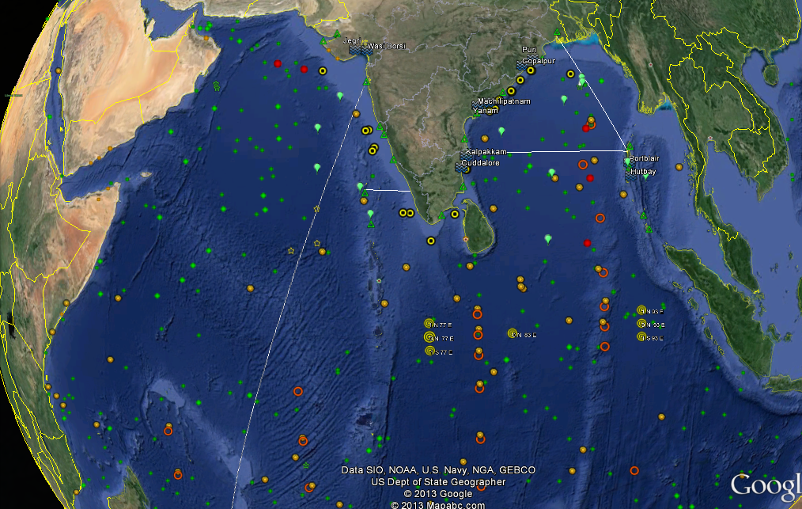
In-situ Observation Systems by India
Argo, Moorings, ADCP, drifters, RAMA buoys, current meter moorings, XBT, CODAR, Tsunami buoys, wave rider buoys

Slide 16
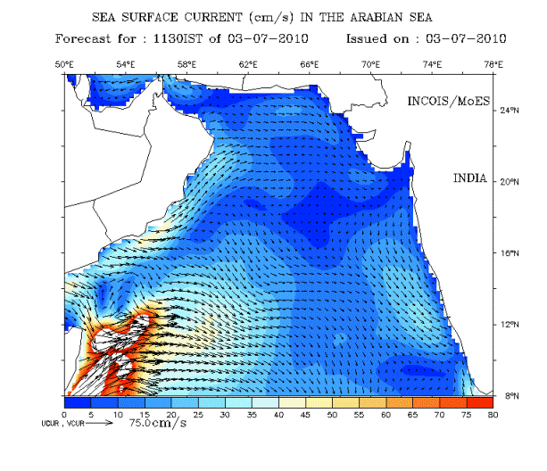
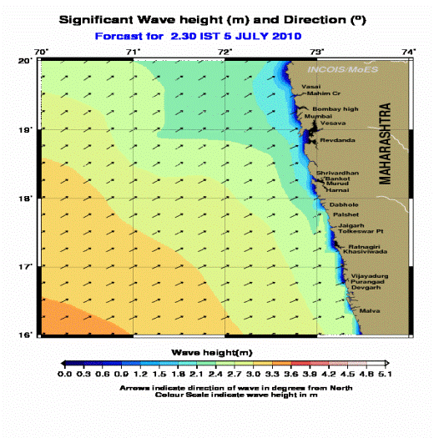
Ocean Modelling
Global forecast (Wave watch III)
Regional forecast (Mike wave and ROMS general circulation)
Sea Surface Currents; Sea Surface Temperature; Mixed Layer Depth; D20
Significant Wave Height; Swell Wave Height; Wave Periods; Swell Wave Periods; Wind Speed
Coastal forecast (Waves; Mike; 10 KM; 7 day ; 3 hourly)
Location specific forecast (Waves; Mike; 5 KM)
Pondicherry; Tuticorin; Tirunelveli; Vizag; Ratnagiri; Karwar
Value added services
High wave alerts

Slide 17
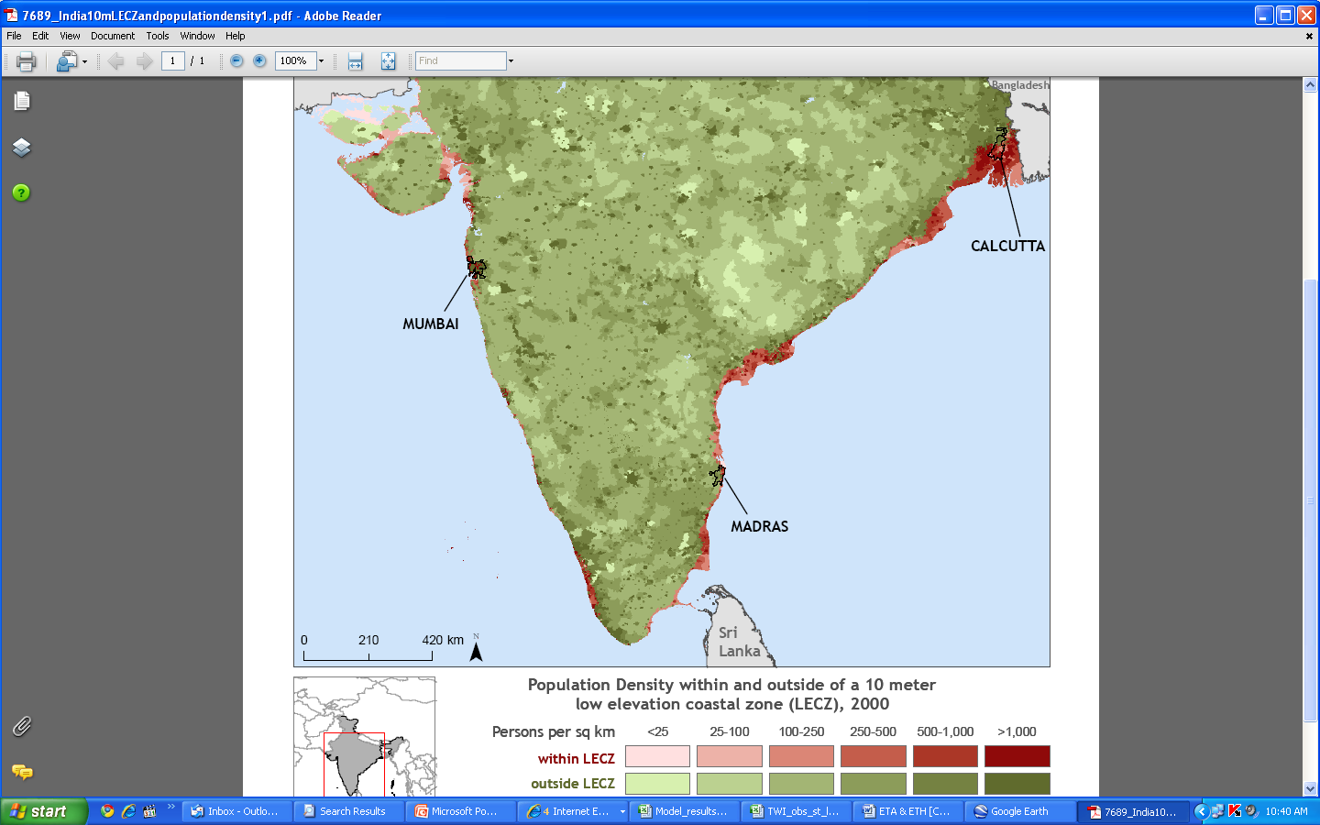
Vulnerability of the Indian Ocean Coastline to Oceanogenic Disasters
More than 50 Nations around
Many are Developing Countries
250 million live within 50 km of the coast
3,600 fishing villages
12 major ports and 185 minor ports
4,120 sq km of mangroves
More than1.5 Billion Population
More than 66,500 km coastline
Shoreline erosion and hazardous storms greatly affect coastal environment quality (edaphic), limiting agriculture land use and its mitigation.
Most of the coastal areas are low lying and vulnerable to oceanogenic disasters such as Tsunamis, Storm Surges, Sea-level rise
Frequent Cyclones - 13% of World’s cyclones in the Seas around India
A few Tsunami events in the past - Dec 26, 2004 Tsunami resulted in a loss of 18,045 deaths and 6,47,599 persons displaced
Flooding and Salinity Many coastal agricultural areas are fat, while others have steep coastlines. Low-lying agricultural land is frequently subjected to severe drainage and soil salinity problems due to stagnation of rain and runoff water and fooding from rivers or periodic storm surges

Slide 18
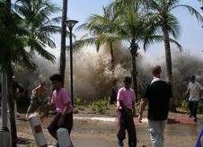
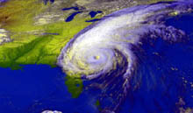
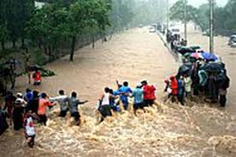
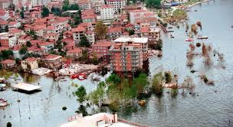



Oceanogenic Disasters
Tsunami, Cyclones, Storm surge, Sea level rise, Coastal erosion, High Waves, etc.
13% of World’s cyclones
in the Seas around India
Annual; Frequent phenomenon
Inundation of Coastal areas
Coastal
Inundation
Damage
Tsunami in Indian Ocean
A few events in the past
Inundation of Coastal areas (Large stretches)
Highly devastative Tsunami on
Dec 26, 2004

Slide 19

Characteristics of, and responses to, marine physical hazards
Source: UNESCO/IOC Report on Coastal Vulnerability

Slide 20


Vulnerability and Role of Geospatial Technology
Vulnerability is the degree to which a system is prone to harmful effects of climate change and its variability and extremes (IPCC 2001). Vulnerability is a function of hazard, exposure and sensitivity of physical or biophysical components.
Approach: Deterministic and Probabilistic
Exposure
Sensitivity
Potential Impact
Adaptive Capacity
Vulnerability
Geospatial Technology plays a vital role in the disaster management cycle for information and informed decisions
2018 Humanitarian Needs Overview (HNO)

Slide 21
Coastal Vulnerability Mapping
Tsunami Hazard Vulnerability
Storm Surge vulnerability
Shoreline Change
CVI
MHVM
3D GIS
Socioeconomic Vulnerability

Slide 22

Tsunami Inundation modeling and vulnerability mapping
Base Data Used
Topography and Bathymetry Data
ALTM data for the coasts between Paradeep- Kochi
Carto-DTM for the Indian Mainland.
RTK-GPS data collected in some areas using GPS
Bathymetry data available from all the sources
Historical & Worst case scenario
Parameters | Source | Longitude | Latitude | Magnitude
Sumatra 2004 | Sumatra | 95.85⁰ E | 3.32⁰ N | 9.3 Mw
Car Nicobar 1881 | Car Nicobar | 92.43 | 8.52 | 7.9 Mw
Andaman 1941 | North Andaman | 92.5⁰ E | 12.1⁰ N | 7.7 Mw
Marakan 1762 | Arakan | 94 | 19 | 8.8 Mw
Worst-Case | Car Nicobar | 92.43 | 8.52 | 9.3 Mw
Worst-Case | North Andaman | 92.43 | 8.52 | 9.3 Mw
Notes:
Input data used for the modelling and the source of historical tsunami considered

Slide 23


Mapping of Coastal Vulnerability to Tsunamis
Vulnerability classification
Low risk – Carnicobar Eq (8.1.Mw)
High risk – Sumatra Eq (9.3Mw)
Maximum risk – Hypo. Carnicobar Eq (9.3 Mw)
II. Inundation Depth
water level due to Sumatra 2004
III. Others details
From Satellite Imagery
Landuse
From DC images (upto 2 km from coast)
Elevation Contours
Infrastructure details
Trees
Roads
Railways
Buildings
Secondary data
Cadastral boundaries and Survey Nos
Administrative boundaries
1:25000
1:5000
Notes:
23

Slide 24





Storm Surge Early Warning
Rushikulya river
Cyclone track
Customized and configured ADCIRC model for the Indian Ocean domain.
Blended parametric and global model winds.
Probabilistic Storm Surge (P-Surge) estimation.

Slide 25



Mapping of Coastal Vulnerability to storm surge

Slide 26


Shoreline Change Studies ...
Shoreline change in Lakshadweep Islands
Satellite data gives useful insights in assessing the long term shoreline changes
GIS analysis helps in understanding the spatio-temporal dynamics
The integration of the relevant information will enable us to understand possible cause
Plan for the remedial measures
The technology also useful in understanding the future implications

Slide 27


Shoreline Change Studies ...
Impact of Coastal Structures on the shoreline
The construction of breakwater structures disturbs the natural coastal processes
As the net drifts is towards the north in this region, northern parts observed increased erosion due to a lack of sediments for the natural coastal currents.

Slide 28

Assessment of Coastal Vulnerability Indices (CVI)
Data Used
Methodology
Coastal Geomorphology
Coastal Regional Elevations
Coastal Slope
Shoreline-change Rate
Parameter | Data
Geomorphology | IRS LISS-IV
Slope | GEBCO
Elevation | SRTM
Tidal Range | Astronomical tide from WXTide-32
Shoreline Change Rate | Landsat data (1972-2000)
Historical Sea Level | GLOSS long term tide gauge observation
Significant Wave Height | Simulated data from Mike model
Geological
Input Parameters
Sea-level-change Rate
Mean Significant Wave Height
Tide Range
Tsunami Run-up
Physical
Risk Rating
CVI = √ [(a*b*c*d*e*f*g)/7]
Analysis
Where
a = Shoreline change rate (m/y)
b = Sea level change rate (mm/y)
c = Coastal slope (degree)
d = Significant wave height (m)
e = Tide range (m)
f = Coastal regional elevation (m)
g = Coastal geomorphology
CVI Maps
Output
Coastal Vulnerability Atlas

Slide 29



Coastal Vulnerability Atlas
CVI Atlas covering Indian coast comprising 156 maps on 1:1lakh scales has been prepared and released on May 09, 2012
Atlas Released
on 10/05/2012
INCOIS, (2012). Coastal Vulnerability Atlas of India. INCOIS-ASG-CGAM-CV-2012-01, Pages 212, Maps 156, INCOIS, Hyderabad, India. ISBN 978-81-923474-0-0.

Slide 30
Coastal Multi-hazard Vulnerability Assessment
“The Multi-Hazard Map is a “composite, synthesized and overlay of multiple hazards”
Predicted 100 year flood level
Composite 100 year hazard line
Coastline in 1950
Coastline in 2005
10m
20m
5m
Predicted erosion in 100 yrs

Slide 31
Data and Parameters
Data | Resolution (m) | Period | Parameters
ALTM | 5 | 2007 | Elevation Contours
Carto DTM | 10 | 2006-07
Landsat, MSS | 57 | 1972 | Shoreline Change
Landsat, TM | 30 | 1990
Landsat, ETM | 30 | 2000
Tide gauge | -- | 1952-2005 | Sea Level Change
Hourly Tide gauge data and Published sources |  |  | Extreme Water Levels

Slide 32









Examples of 3D Mapping Techniques
High Altitude
Very Low Altitude
IKONOS Cartosat
Quickbird
Worldview
Etc.
Low Altitude
Terrestrial

Slide 33

Assessment of extreme water level from historical tide data
A
B
Return Period
Where,
‘U’ is the extreme water level
‘R’ is the return period in years,
‘a’ is the slope (fig.A)
'u’ is the intercept (fig.A)
Probability of non-exceedence
Where,
‘m’ is rank of the variable (Water level)
‘N’ is the total number of observations
The SLRP-2 has been used to calculate the predicted data to estimate the residuals
Extreme Water level return period was estimated for the above stations based on the Grigorton probability distribution method

Slide 34






Coastal Multi-hazard Vulnerability Assessment
Extreme Water Level and return periods
INPUTS
High Resolution Topography
Sea-level Change Rate
Shoreline Change Rate
SYNTHESYZED SPATIAL OVERLAY ANALYSIS
OUTPUTS
Composite Multi-hazard Line
Multi-hazard Vulnerability Map
Composite Multi-hazard line
Notes:
Process of generation of the MHVM

Slide 35


Composite Multi-hazard Line
Composite Multi-hazard line
0
8.0
Meters

Slide 36


Multi-hazard Zones
Hazard Zone
Safe Zone

Slide 37


Landuse/Landcover

Slide 38

Roads
Vannara Palyam Road
Beach Road
Peliyar Kovil Street
Mettu Street
Beach Road
Kovil Teru Street
Roads
Major
Minor
Streets

Slide 39

Buildings
Buildings

Slide 40

Layer Integration
Buildings
Roads
Hazard Zone
Hazard
Major
Safe Zone
Minor
Safe
Streets

Slide 41

Risk Map
Risk
High
Moderate
Low
No Risk
Coastal Geospatial Applications Mission, ASG

Slide 42

Hazard Management
Risk
Buildings
Roads
High
Hazard
Major
Minor
Moderate
Safe
Streets
Low
Evacuation
Routs
No Risk

Slide 43








3D GIS Mapping
3D Buildings with Socio-economic data of Pondicherry
High Vulnerable Areas
3D Buildings of Machilipatnam
3D Buildings with Socio-economic data
Of Machilipatnam
3D Buildings of Machilipatnam
MHVM
High Vulnerable Areas
3DVAS
3D Buildings of Pondicherry
Puri
Kakinada
Machilipatnam
Nizampatnam-Vatapalem
Chennai
Cuddalore-Pondicherry
Rameshwaram
Alleppey- Chevara
Tuticorin

Slide 44










Coastal Risk Assessment at Building level
Socio-Economic Risk for Tsunami
Building Risk
Building Risk
Building Risk
Very High
Very High
Very High
High
High
High
Inundation
Depth
Moderate
Moderate
Moderate
3m
Low
Low
Low
2m
1m

Slide 45





Inundation Modelling and risk assessment in 3DVAS
Model setup, propagation and inundating modeling,
Overlay of the modeling results and risk assessment at building level and generation of outputs

Slide 46





MHVM risk assessment up to village level
Mahendra et al., 2021

Slide 47





Socio-Economic Vulnerability Index case study1
Sensitivity (social)
(1) Small and marginal farm(ers) (SMF)
(2) Agriculture labourers (AL)
(3) Fishers population (FP)
(4) Malnutrition (FSM)
(5) Population density (PD)
(6) SC/ST population (SCST)
Sensitivity (economic)
(7) Net sown area (NSA)
(8) Annual rainfall (AR)
(9) Dependence on natural resource (DNR)
(10) Distance to nearest town (DNT)
(11) Distance to nearest hospital (DNH)
Adaptive capacity (social)
(1) Education status (ES)
(2) Household amenities (HA)
(3) Housing condition (HC)
(4) Community infrastructure (CI)
(5) Population growth rate (PGR)
(6) Gender ratio (GR)
Adaptive capacity (economic)
(7) Transport and communication (TC)
(8) Economic dependency ratio (EDR)
(9) Access to market (AM)
(10) Net irrigated area (NIA)
(11) Groundwater development (GD)
(12) Livestock population (LP)

Slide 48



Socio-Economic Vulnerability Index case study2
54 indicator parameters

Slide 49






Socio-Economic Vulnerability Index case study3
Index Category | Parameters
Exposure Index | MHVM Zones
 | Elevation
Sensitivity (Social) | Marginal workers
 | Population Density
 | SC/ST percentage
Sensitivity (Economic) | Annual Rainfall
 | Distance to Nearest Town
 | Distance to Nearest Hospital
 | Non-worker Percentage
 | The average size of households
Adaptive capacity (social) | Sex Ratio
 | Literacy Rate
 | Average Cultivable land per Household
 | Work Participation Rate
Adaptive capacity (Economic) | Net Irrigated area
 | Transport Facility
 | Banking Facility
SEVI=SI/1+ACI
CVI$={\left(EI∗SI\right)}/ACI$
Mahendra et al., 2023

Slide 50

Temporal patterns of recurrent coral bleaching.
(A) Number of 100 pantropical locations that have bleached each year from 1980 to 2016. Black bars indicate severe bleaching affecting >30% of corals, and white bars depict moderate bleaching of <30% of corals.
(B) Cumulative number of severe and total bleaching events since 1980 (red; right axis) and the depletion of locations that remain free of any bleaching or severe bleaching over time (blue; left axis).
(C) Frequency distribution of the number of severe (black) and total bleaching events (red) per location. (D) Frequency distribution of return times (number of years) between successive severe bleaching events from 1980 to 1999 (white bars) and 2000 to 2016 (black bars).
Terry P. Hughes et al. Science 2018;359:80-83
Notes:
Slide showing the increased frequency of coral bleaching globally

Slide 51





Coral Bleaching Alert System (CBAS) - A satellite derived SST based Service
Methodology
Coral Bleaching
Threshold
Service initiated since Feb 2011 and 122 advisories provided every year
Recent bleaching event was recorded during the April-May 2016 at Andaman validated with Field Data
“Satellite based advisory service to predict thermal stress on an important coral ecosystem”

Slide 52







Spatio-temporal changes in the coral environs due to 2004 Sumatra Eq.
Tectonic disturbances
Total Coral Area
Exposed Reefs
Tobita, et al, 2005
Total area of exposed category recorded ~113 km² from Andaman Islands

Slide 53
Thank you

