Slide 1


Training Course on
" Coastal Vulnerability mapping and Analysis using QGIS"
24-29 November, 2024
Dr. P C Mohanty mohanty.pc@incois.gov.in
International Training Centre for operational Oceanography (ITCO),
INCOIS, Hyderabad, India
Hands-on
Shoreline Change Mapping

Slide 2
Overview of Course
Download Two period landsat data (Landsat ETM+ (15, Nov 2000) and Landsat 8 LOI (26 Feb 2018)
Digitize two period shoreline with suitable band combination
Create Transect and calculate shoreline change rate along the transect line.
Generation of Shoreline Change map and calculation of Statistics

Slide 3
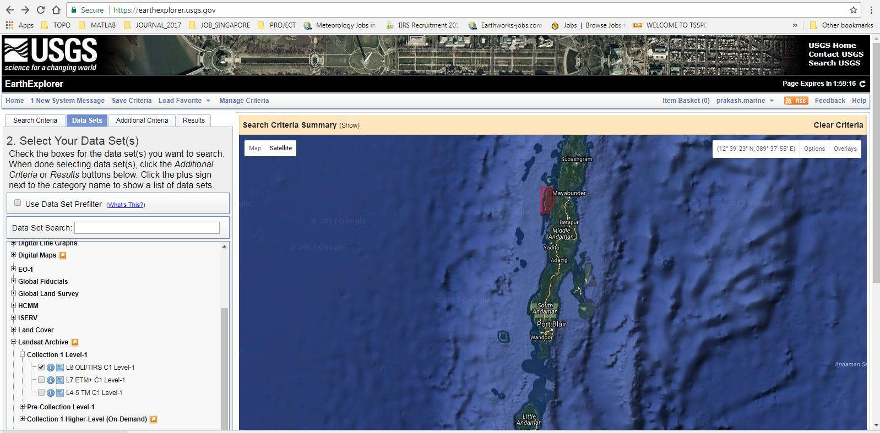
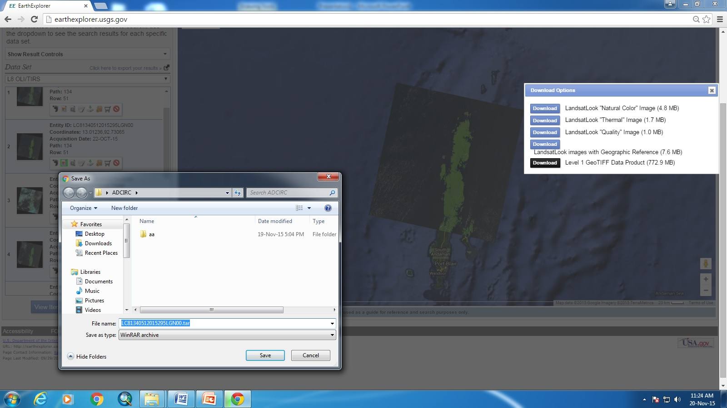
Download Landsat data
Go to http://earthexplorer.usgs.gov/ and create new user account (login)→ Landsat Archive → set search criteria based on user place and accusation time of Landsat data → Download tar file from Archive
Download Landsat 8 LOI Label-1 product data set on dated 26-Feb-208 image > Unzip file

Slide 4
Band Configuration of Landsat 8 LOI
Bands | Wavelength (micrometers) | Resolution (meters)
Band 1 - Ultra Blue (coastal/aerosol) | 0.435 - 0.451 | 30
Band 2 - Blue | 0.452 - 0.512 | 30
Band 3 - Green | 0.533 - 0.590 | 30
Band 4 - Red | 0.636 - 0.673 | 30
Band 5 - Near Infrared (NIR) | 0.851 - 0.879 | 30
Band 6 - Shortwave Infrared (SWIR) 1 | 1.566 - 1.651 | 30
Band 7 - Shortwave Infrared (SWIR) 2 | 2.107 - 2.294 | 30
Band 8 - Panchromatic | 0.503 - 0.676 | 15
Band 9 - Cirrus | 1.363 - 1.384 | 30
Band 10 - Thermal Infrared (TIRS) 1 | 10.60 - 11.19 | 100 * (30)
Band 11 - Thermal Infrared (TIRS) 2 | 11.50 - 12.51 | 100 * (30)

Slide 5
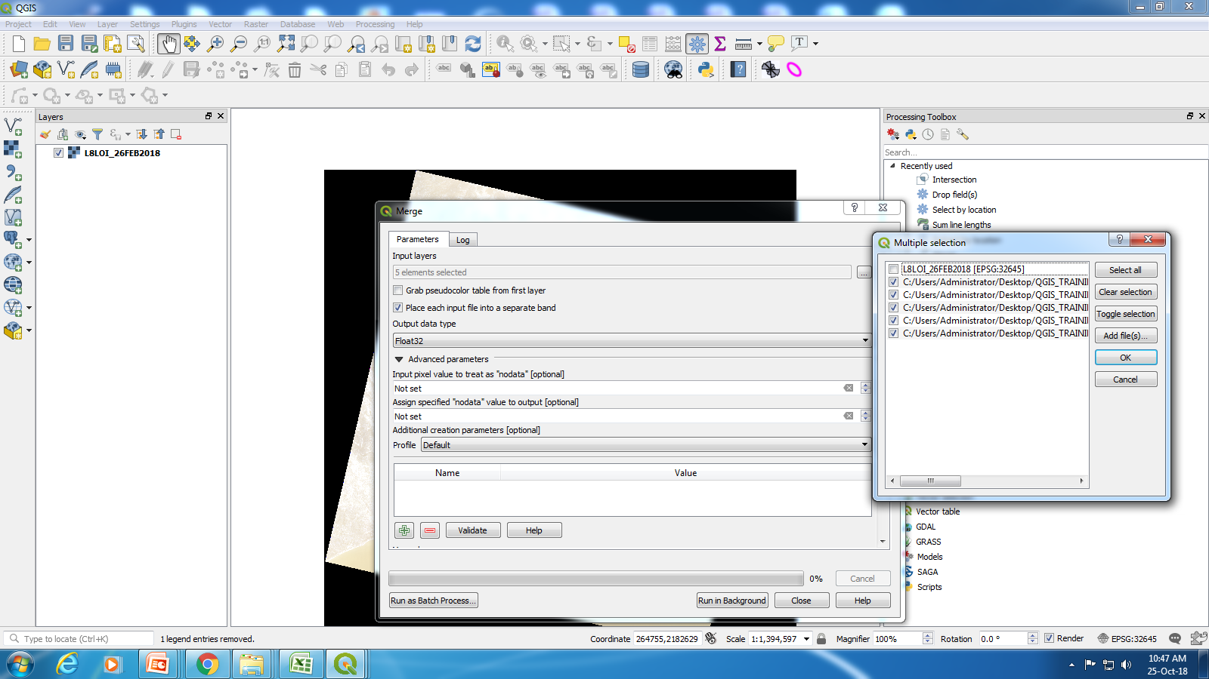
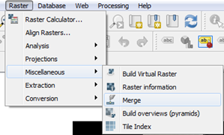
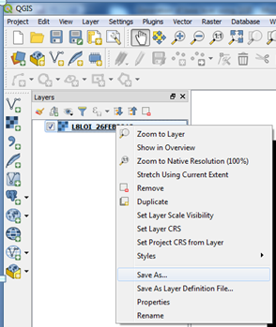
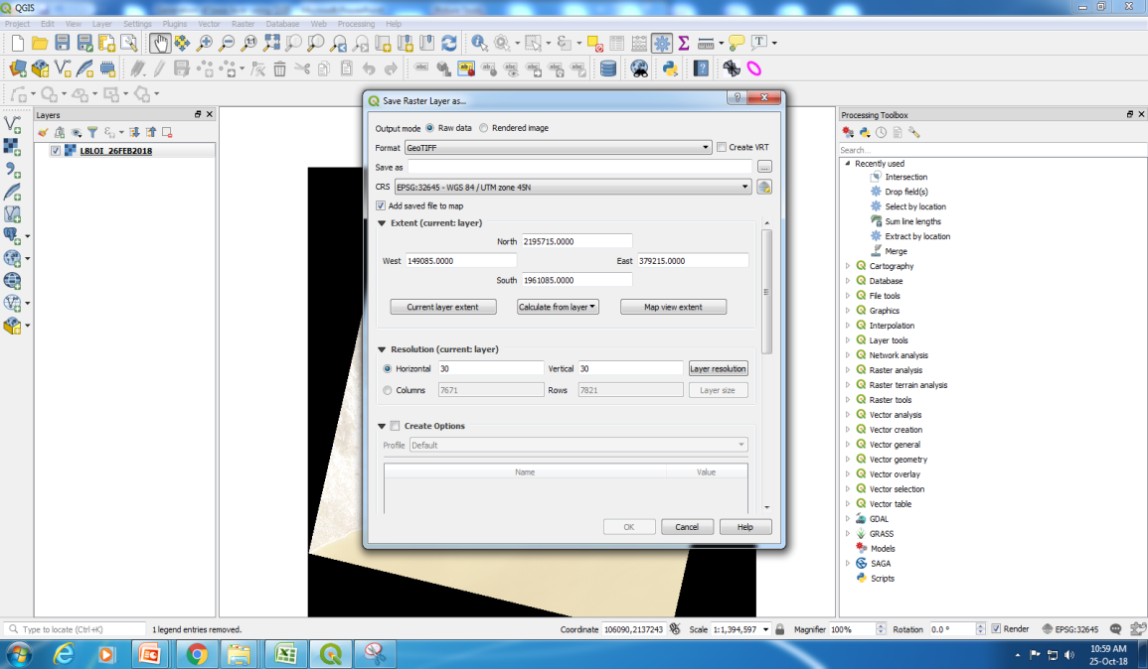
Band composite:
Create composite image: Go to Raster> Miscellaneous> merge> click layer input>multiple selection window will popup then add file of Band-1 to band-5 from working folder > check on input file into separate file> click on run background then it will run and layer stack file will store in temp folder.
Save file: right click and click on save as > new window will pop-up> save file.

Slide 6
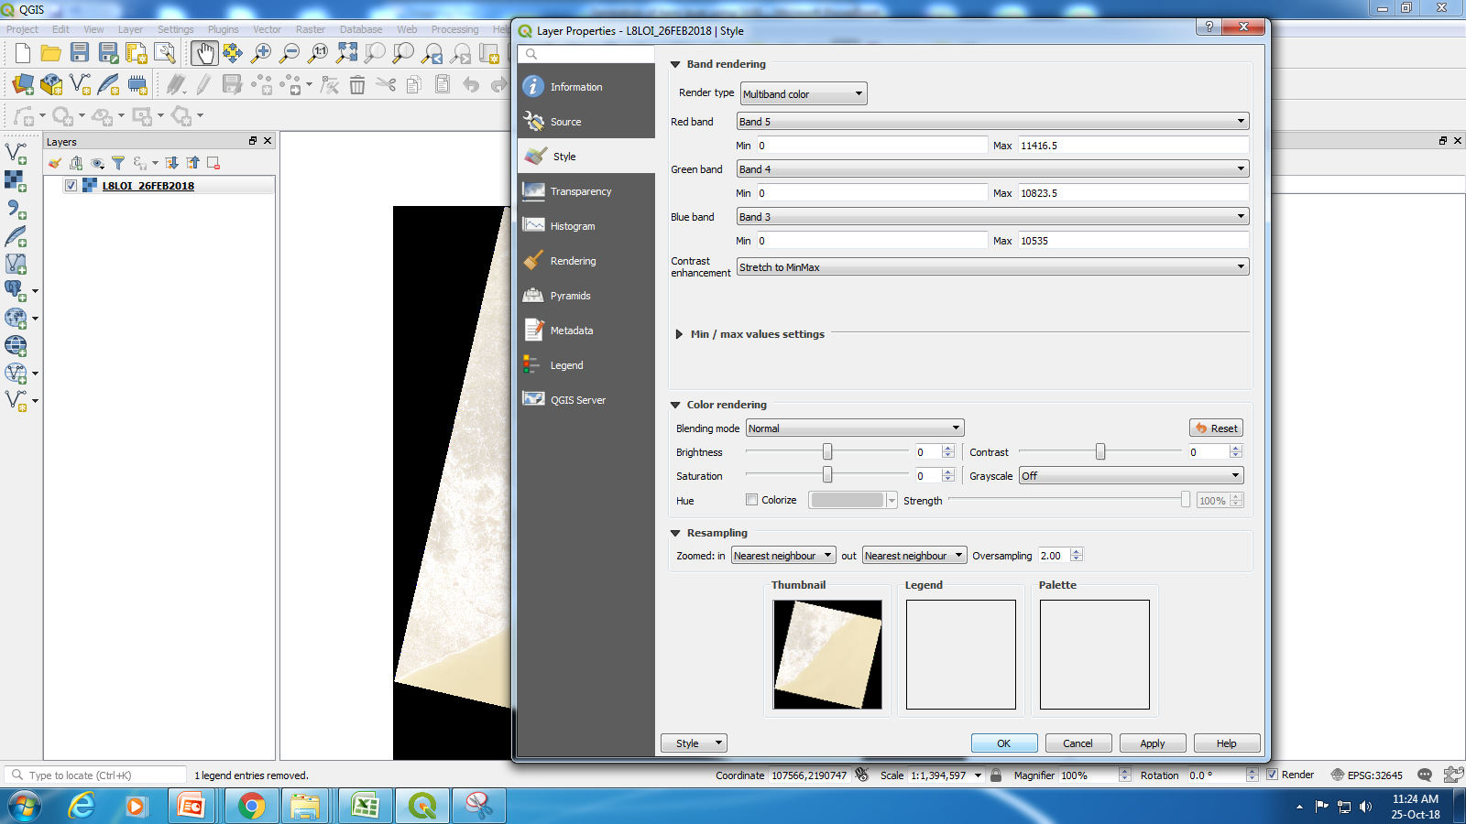
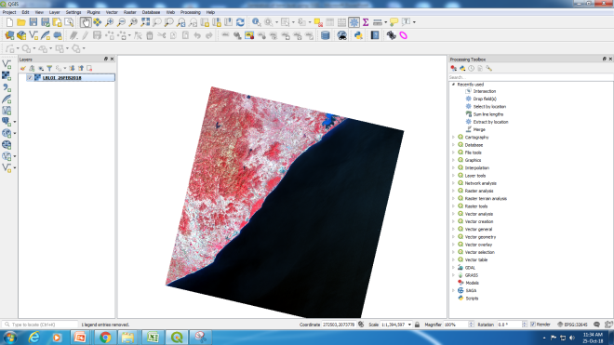
Create the FCC composite band for display
Open raster file> Right click on file> properties > Render type as multi-band color> assign Red band into B5,green into B4 and Blue into B3.> OK
Click on transparency> additional no data value is 0
Now it will display FFC image.

Slide 7
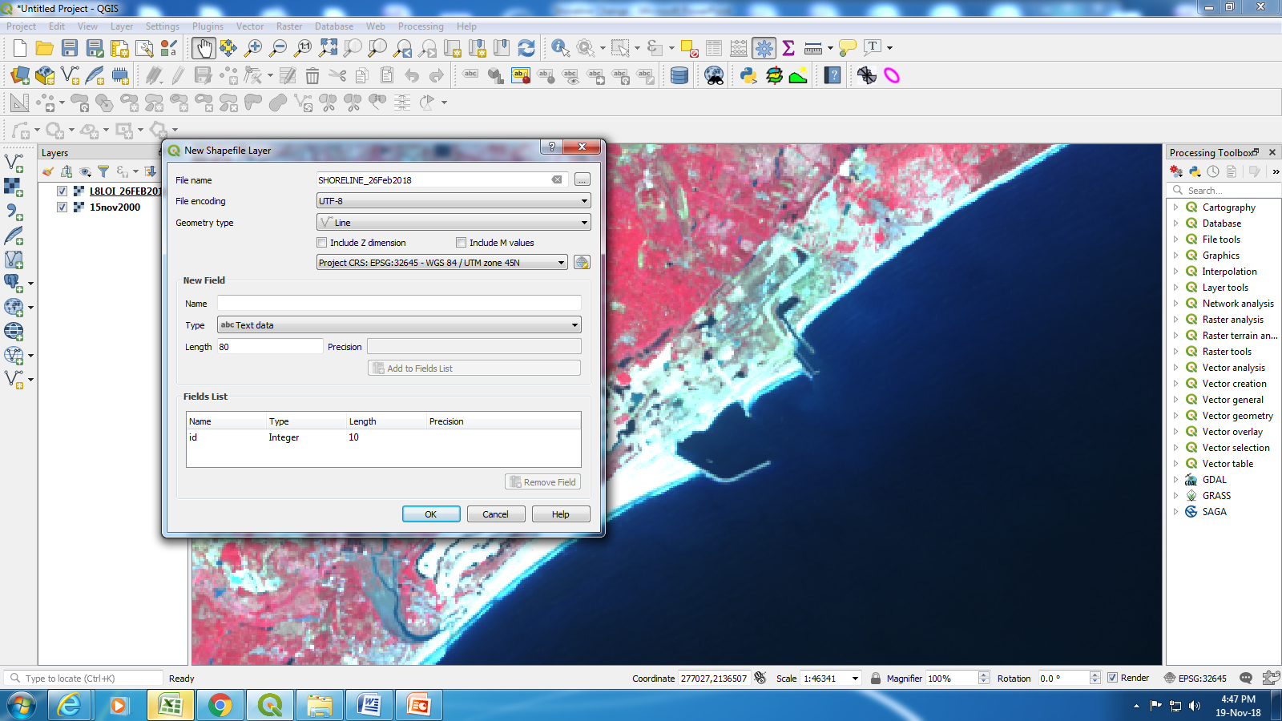
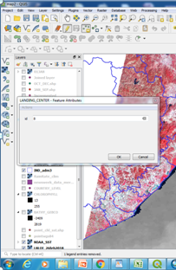
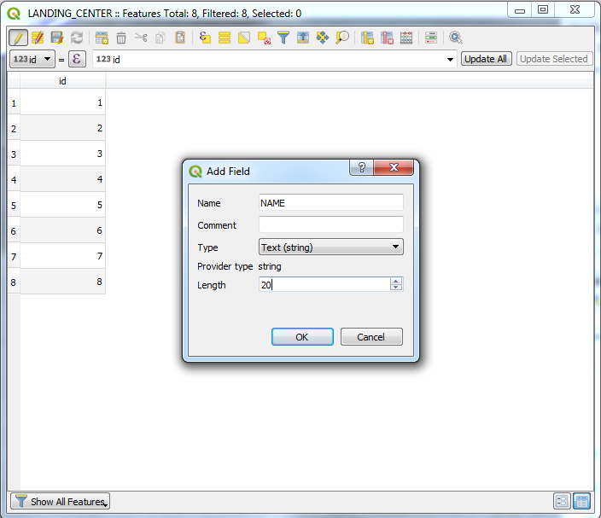
Digitize shoreline
Click to create new layer
Add new line
Add new field
To create New layer (vector Layer): Click on New shp file layer > insert file name> change geometry type (line) > insert field name and change data type>
digitize feature : click on toggle editing (it will activate editing mod > click on add line> after complete save the layer

Slide 8
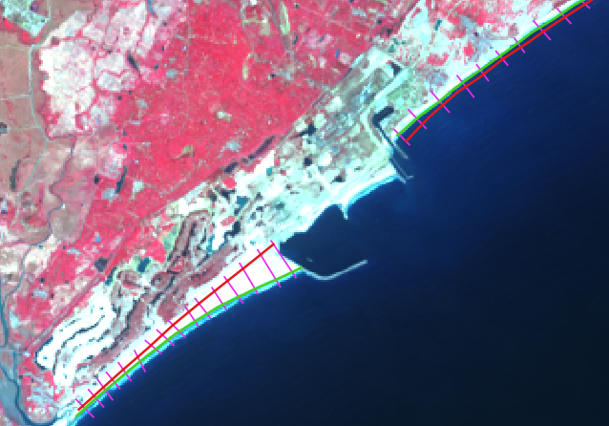
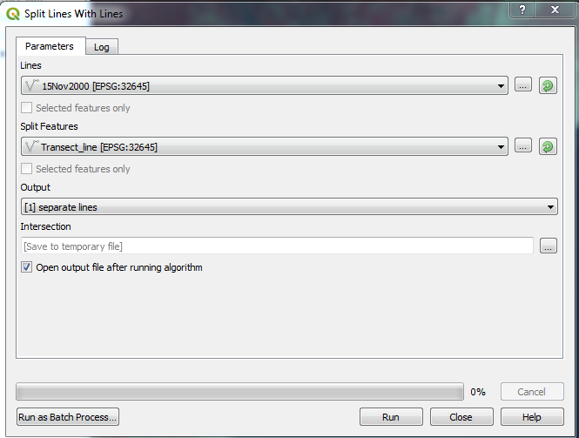
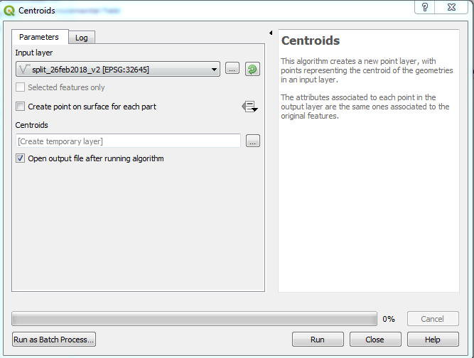
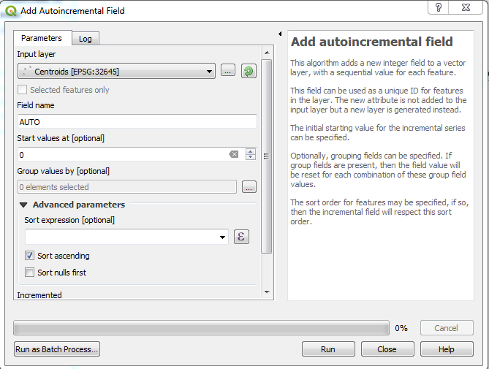
Create Individual Shoreline, Transect and Primary Key ID
Digitise two shoreline and transect line> Split Individual Shoreline with Transect line> convert line to center point using centroid tool in each split shoreline> create auto ID using add auto incremental field tool>

Slide 9
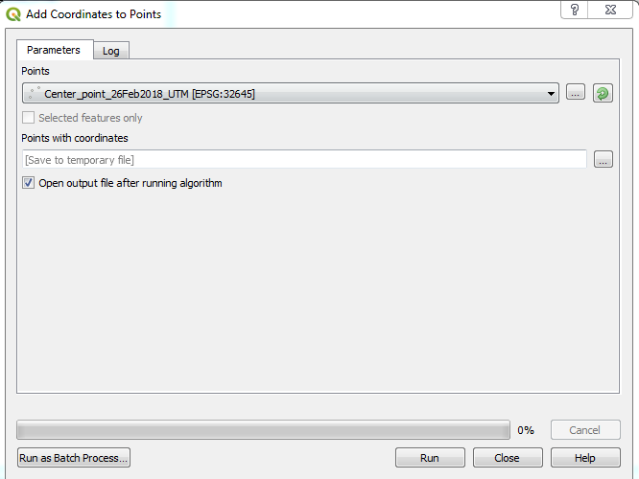
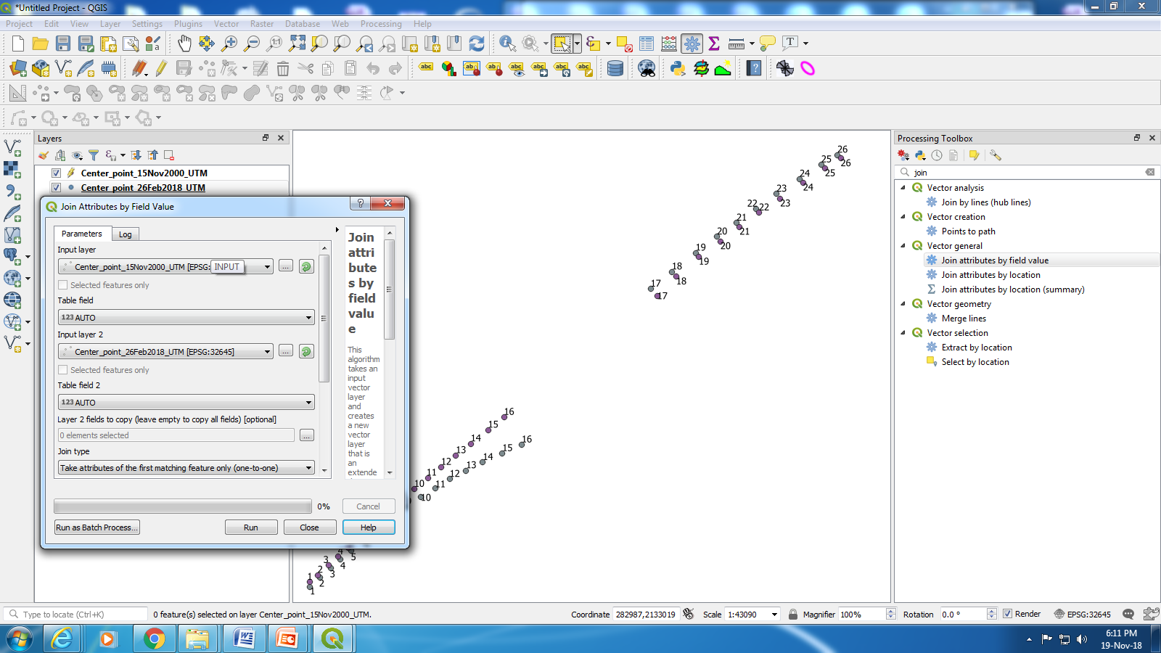
Add coordinate on centroid points
Add coordinates on each centroid points using add coordinates to points tool>join by attribute of 1st shore line with 2nd shoreline based on common ID (primary Key)

Slide 10
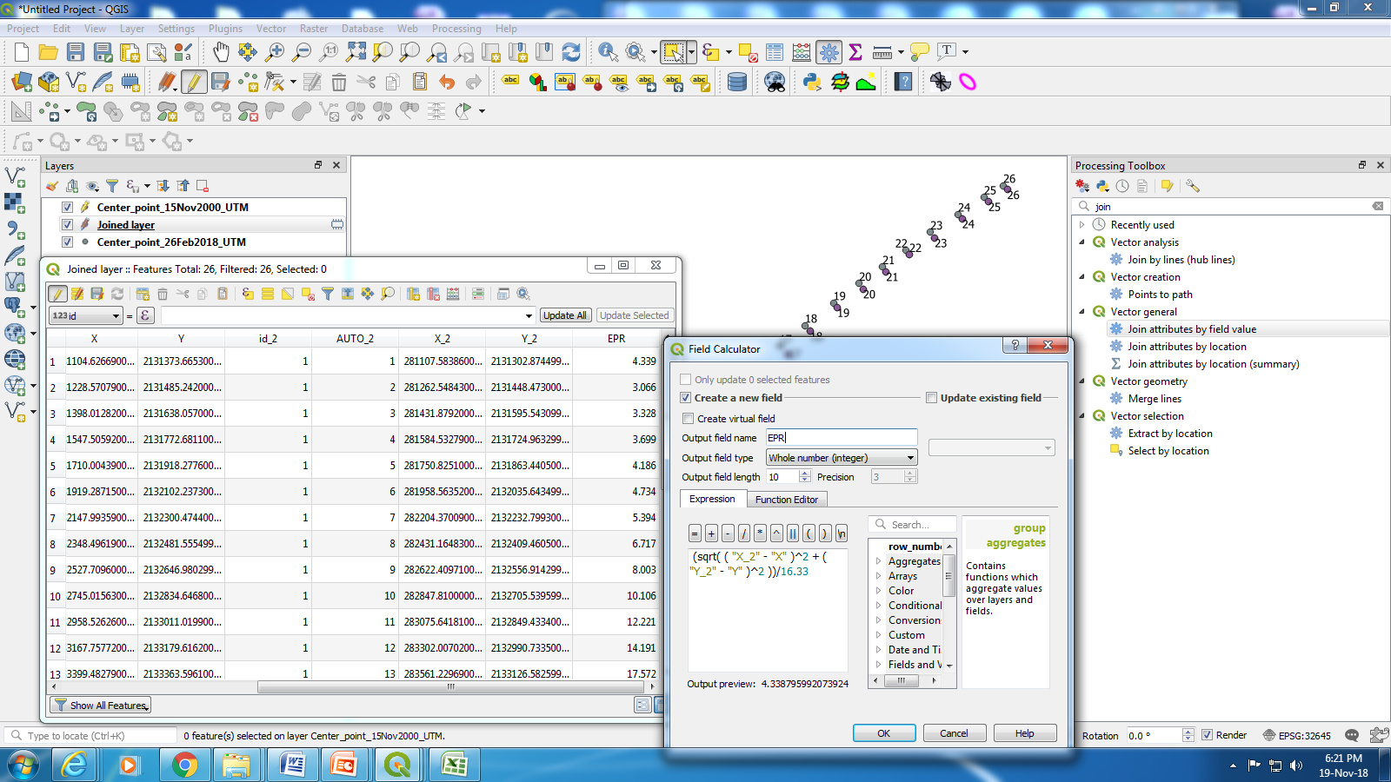
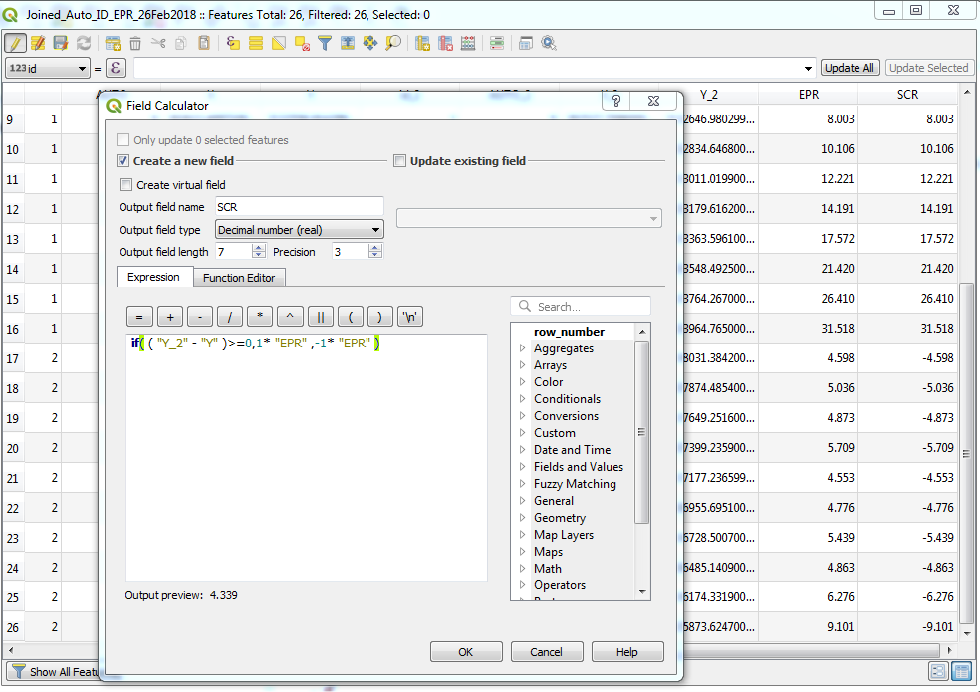
Calculation of Shoreline Change rate (m/y)
Calculate distance formula [using sqrt( (x2 − x1)² + (y2 − y1)²)]:
  add New field: go Join_LC_PFZ_SST_Chl_DEPTH.shp in editing mode> open attribute table> click on open field calculator and put the formula (sqrt( ( "X" - "X_2" )^2 + ( "Y" - "Y_2" )^2 ) /16.33 to calculate the distance.
  Assign sign for erosion(-ve) and accession (+ve) : give the condition if(Y2-Y1>=0 then apply erosion else accession sign

Slide 11
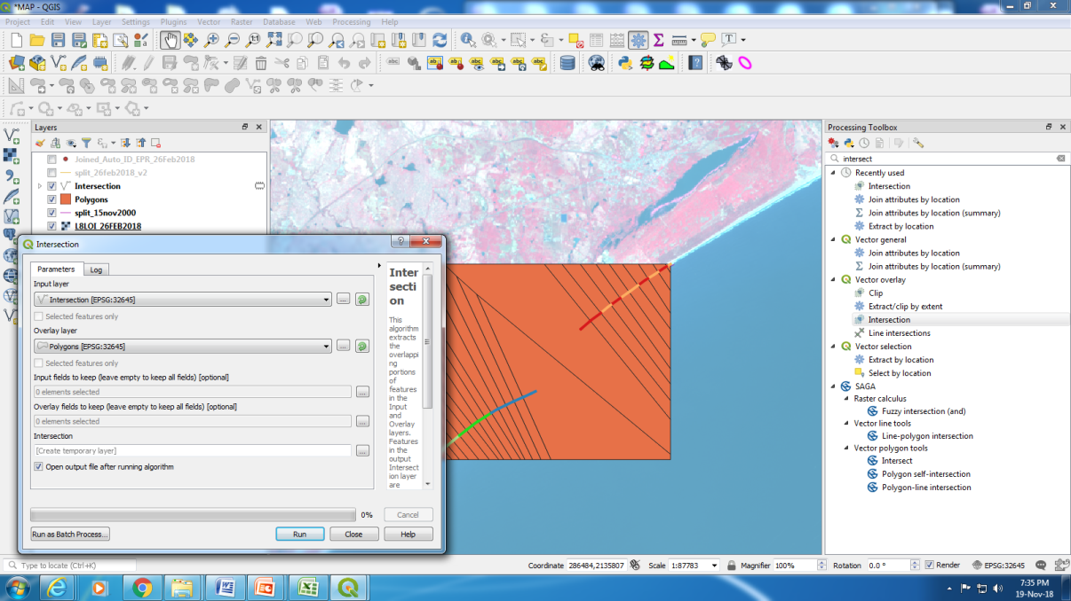
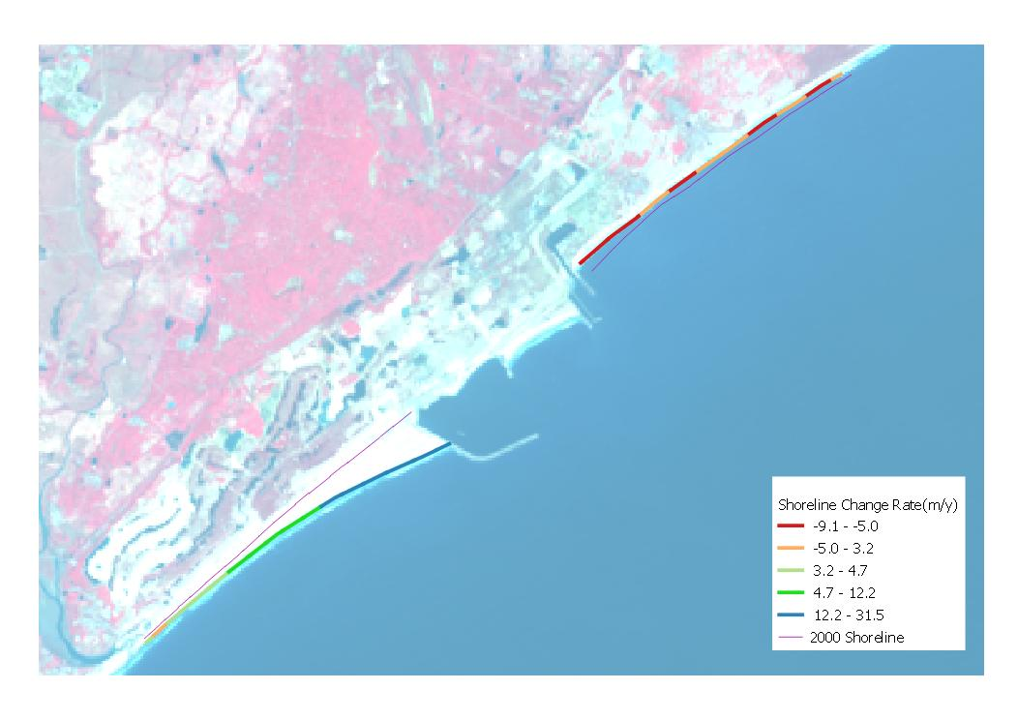
Generate Shoreline Change rate map (m/y)
Create Thiession Poly using Shoreline change rate points and intersect with recent shoreline
Generate Shoreline change rate

Slide 12
Thank you

