Slide 1


Training Course on
"Coastal Vulnerability mapping and Analysis using QGIS "
20-29 November, 2024
Dr. P C Mohanty
Scientist-D, INCOIS mohanty.pc@incois.gov.in
International Training Centre for operational Oceanography (ITCO),
INCOIS, Hyderabad, India
Hands-on
Storm Surge Vulnerability Mapping

Slide 2
Over view of Course
Maximum Wave height due to Phailin cyclone South Orissa coast
Extract Wave height either side of the cyclonic land fall point
Create buffer (multi buffer zone: 2, 5, 10, 20, 30, 40, 50, 100km) around the land fall point
Calculate Statistics w.r.t different zone
Generation of storm hazard map

Slide 3
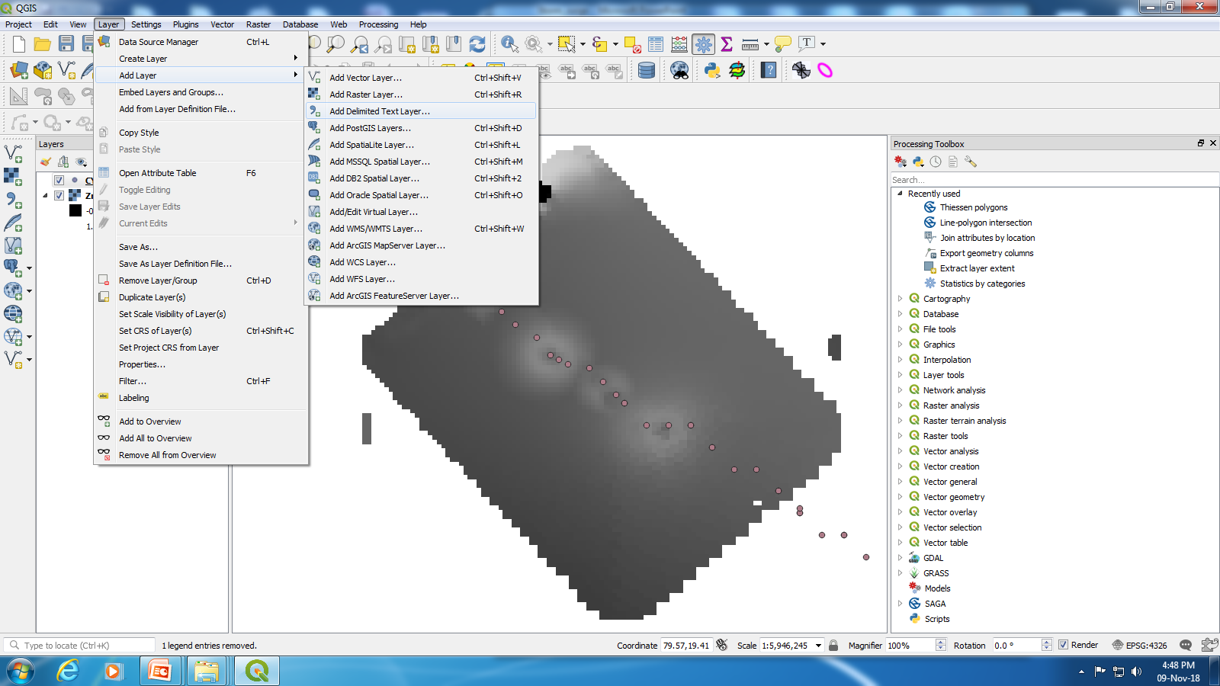
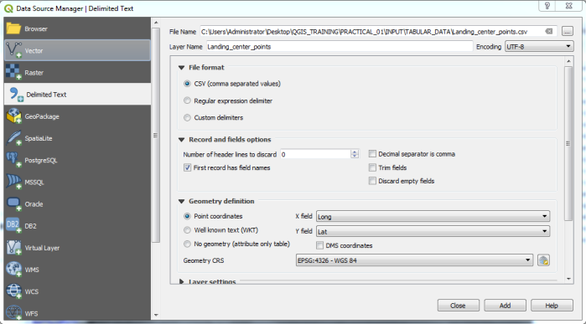
Import cyclone track data of CSV file to .shp file :
Go to layer>add layer>delimited text layer> New window will pop-up> open CSV(MS-DOS) and enter long and lat Coolum> file save as .shp file. > add coordinate to point > save new file (Say Cyclone_track.shp)

Slide 4
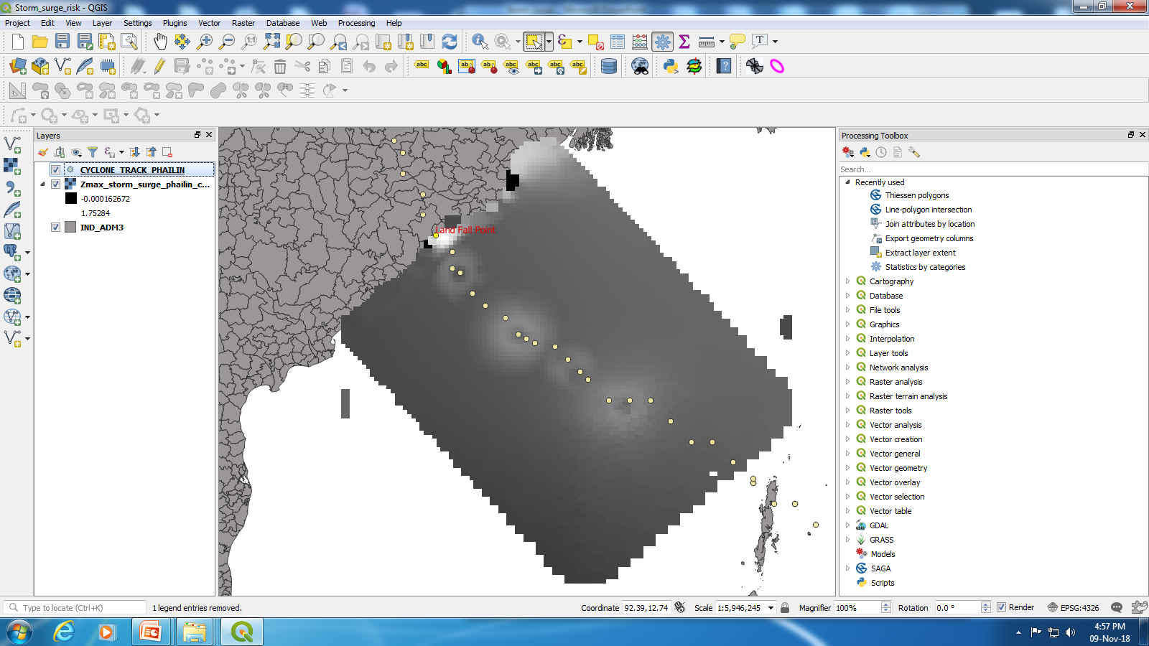
Locate Land Fall point and create multiple Buffer
Go to layer>add layer>delimited text layer> New window will pop-up> open CSV(MS-DOS) and enter long and lat Coolum> file save as .shp file. > add coordinate to point > save new file (Say Cyclone_track.shp)

Slide 5
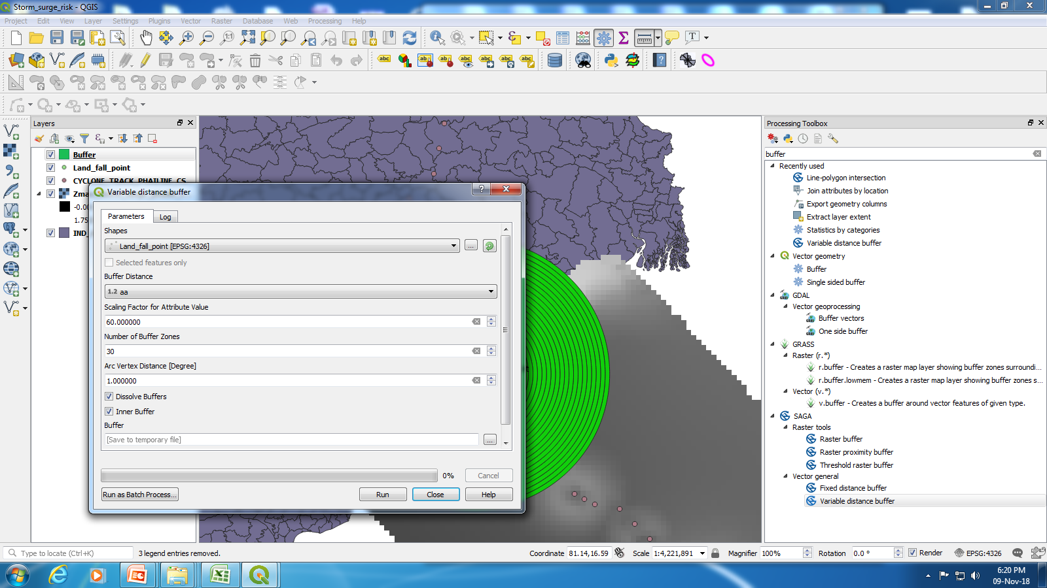
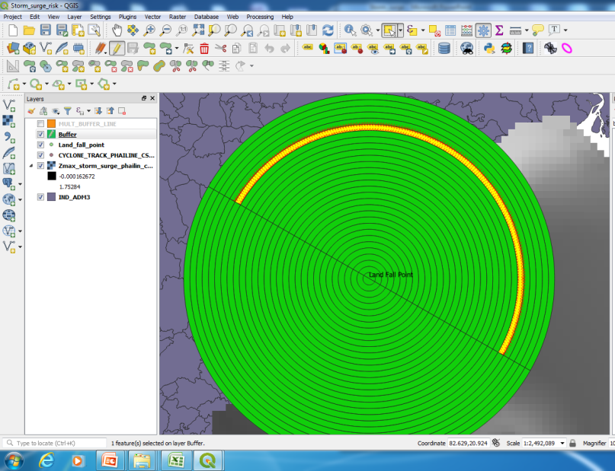
Multi-Buffer:
Draw every 10km interval buffer line using Variable distance buffer tool [insert buffer distance as 0.045 (field has to create), scale factor 60 and no. of buffer line is 30]
Split Buffer into two part to divided left and right side of the cyclone track using editing mode

Slide 6
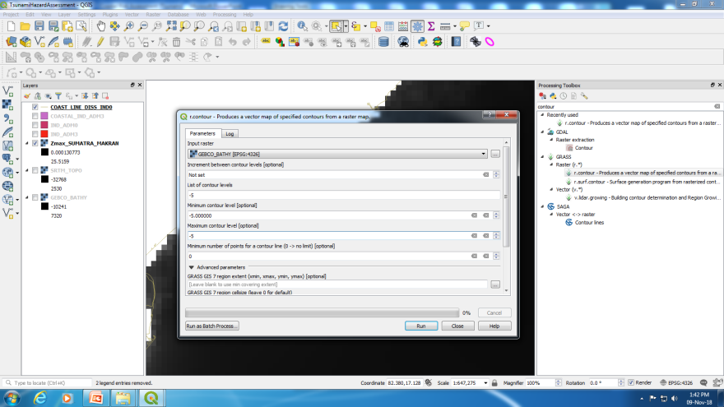
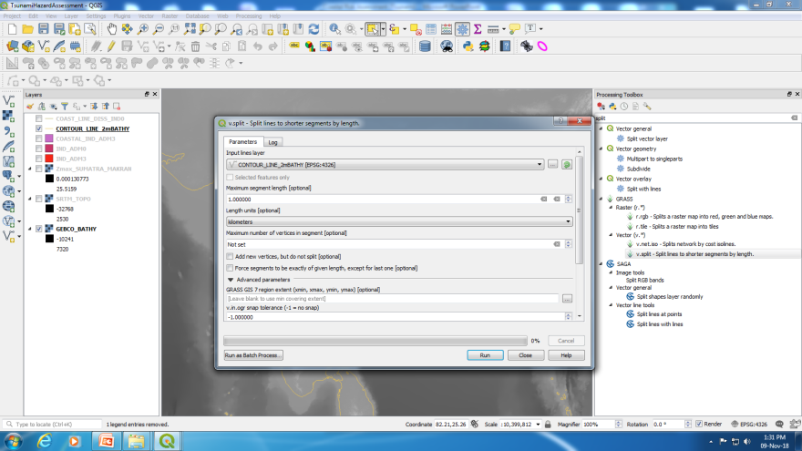
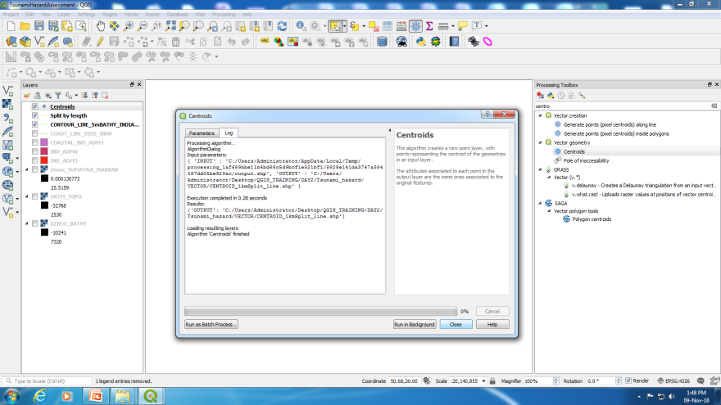
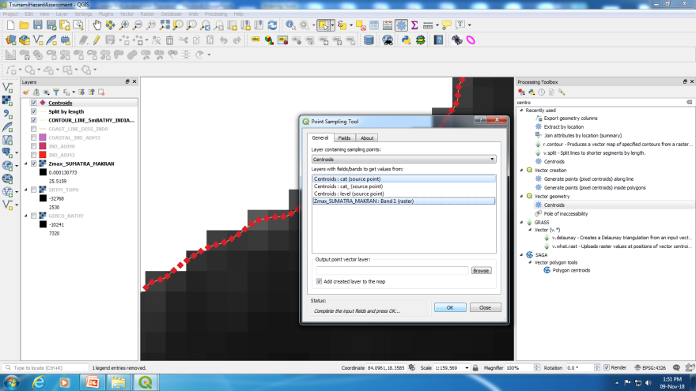
Storm Surge Extraction
Extract storm surge Height: create contour line (-5m) from GEBCO_BATHY.tif file using Specified contour from raster tool> split 1km segment using split line to shorter segment by length tool> generate split line to point using centroids tool> Extract storm surge height at the point location using point sampling tool (Say StormSurgeHeight_pointLocation.shp)

Slide 7
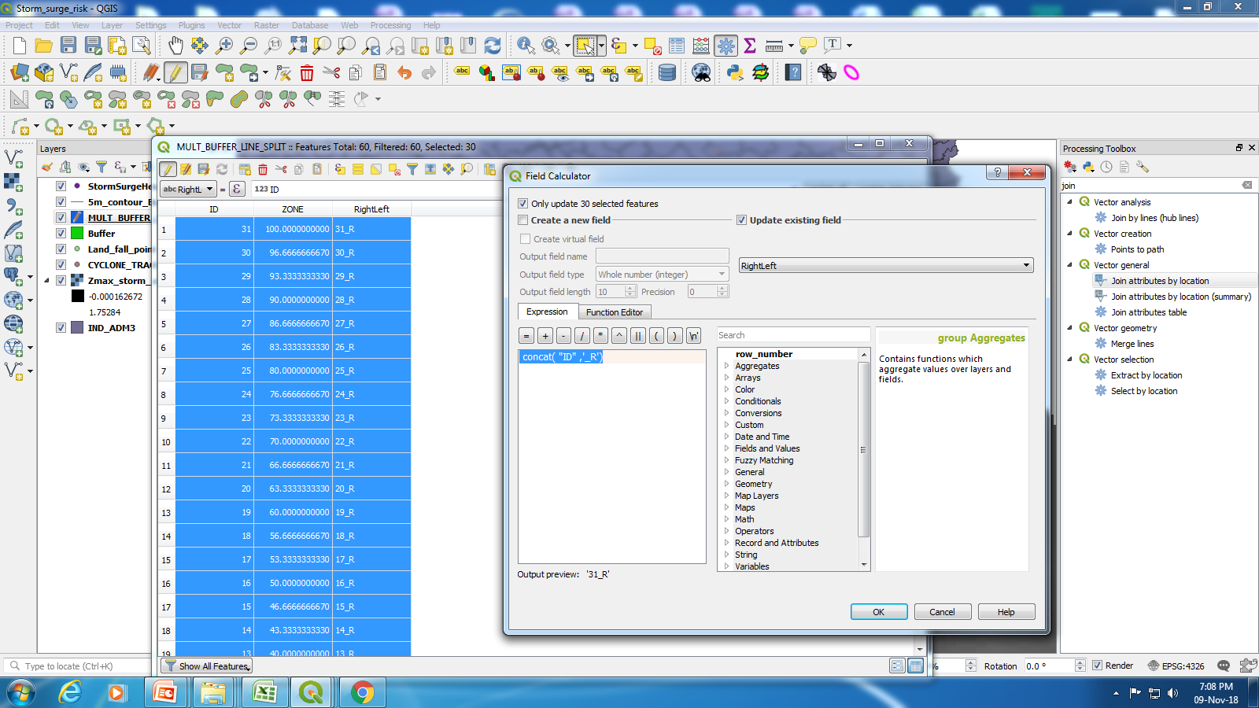
Calculation Risk Rating
Create New Field> Select Left and right side of the buffer and Name them using concat string calculator

Slide 8
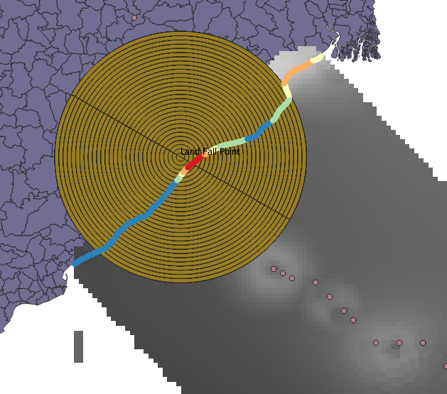
Generate Hazard Maps

Slide 9
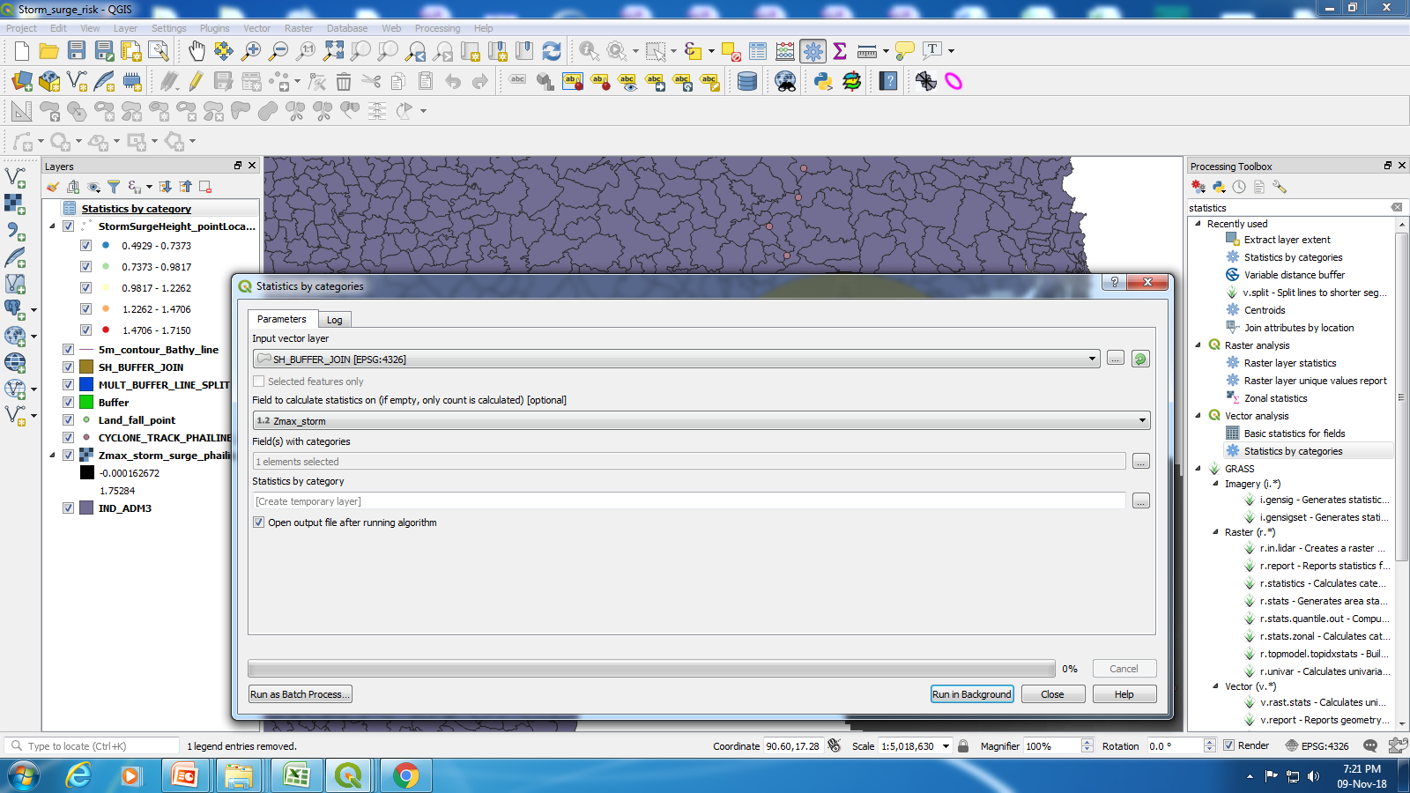
Extraction of Statistics
Calculate Statistics ( Mean, Nin, Max and SD of Zmax and length of the coast in each taluk. Using Statistics by category tool ( here calculate zmax value using the Buffer ( RightLeft) filed category

Slide 10
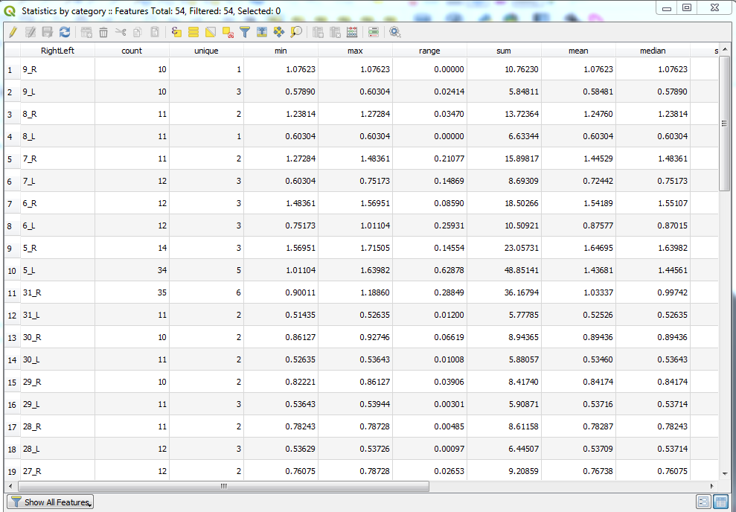
Zonewise Statistics Table

Slide 11
Thank you

